Slide 1

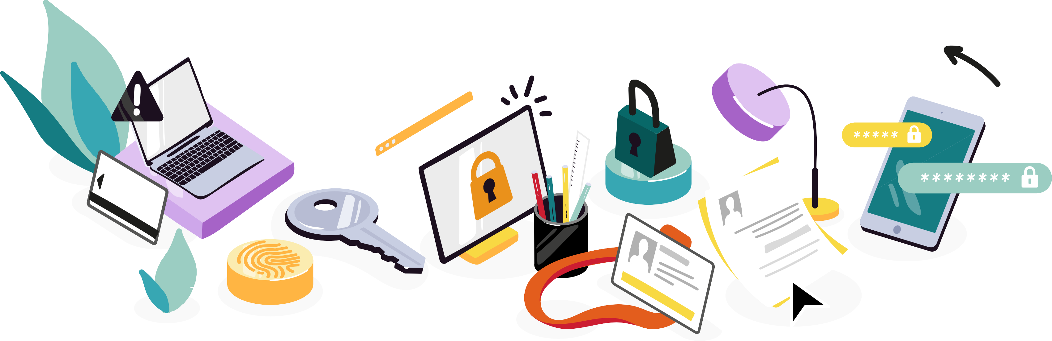
CYBERSECURITY, MY FUTURE CAREER
!
CB
CV
$ +
+
€
Notes:
Participant Guide – Version 3
Added slides 109 to 123 What is a password manager? Focus on KeePass
Added slides 129 to 145 Multi-Factor Authentication (MFA) Which MFA am I?
Added slides 149 to 161 Ask your Cyber-AI coach

Slide 2


CV
CAREER
in CYBERSECURITY

Slide 3

WHY DOES CYBERSECURITY CONCERN US ALL?
HACKERS
LAUNCH ON AVERAGE
8
ATTACKS
ON PASSWORDS
EVERY DAY, THAT’S
₉₂₁/SECOND
SOURCE

Slide 4
WHY DOES CYBERSECURITY CONCERN US ALL?
HACKERS
LAUNCH ON AVERAGE
8
SOURCE
SOURCE
93%
ATTACKS
ON PASSWORDS
OF ALL SECURITY
INCIDENTS COULD HAVE
EVERY DAY, THAT’S
BEEN _{AVOIDED}
₉₂₁/SECOND
IF BASIC RULES CONCERNING
CYBER HYGIENE
SOURCE
HAD BEEN PUT IN PLACE
SOURCE

Slide 5
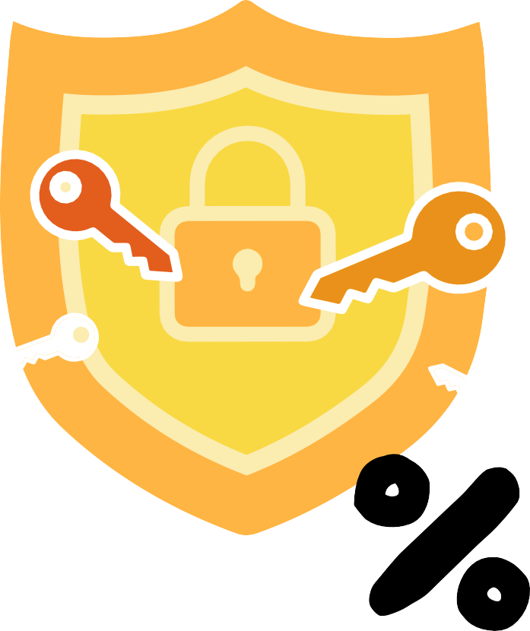
WHY DOES CYBERSECURITY CONCERN US ALL?
HACKERS
LAUNCH ON AVERAGE
8
SOURCE
THE USE OF
SOURCE
93%
MULTI-FACTOR
AUTHENTIFICATION
(MFA)
ATTACKS
ON PASSWORDS
BLOCKS
99,9
OF ALL SECURITY
INCIDENTS COULD HAVE
EVERY DAY, THAT’S
BEEN _{AVOIDED}
₉₂₁/SECOND
OF ATTACKS
IF BASIC RULES CONCERNING
CYBER HYGIENE
SOURCE
HAD BEEN PUT IN PLACE
SOURCE

Slide 6




WHY DOES CYBERSECURITY CONCERN US ALL?
SOURCE
HACKERS
LAUNCH ON AVERAGE
8
SOURCE
THE USE OF
SOURCE
SOURCE
SOURCE
MULTI-FACTOR
SOURCE
93%
AUTHENTIFICATION
2.5M
(MFA)
ATTACKS
ON PASSWORDS
BLOCKS
99,9
OF ALL SECURITY
INCIDENTS COULD HAVE
EVERY DAY, THAT’S
BEEN _{AVOIDED}
₉₂₁/SECOND
GLOBAL CYBERSECURITY JOBS UNFILLED
OF ATTACKS
IF BASIC RULES CONCERNING
CYBER HYGIRNE
SOURCE
HAD BEEN PUT IN PLACE
SOURCE
SOURCE
Notes:
To adapt to specific country

Slide 7



%
cybersecurity
24
cybersecurity
47%
OF CYBER SECURITY WORKERS
ARE UNDER 30
OF NEW
ENTRANTS
20.451likes
ARE UNDER 30
See 245 comments
2 DAYS AGO
22.025 likes
See 245 comments
2 DAYS AGO
Notes:
Find stats or delete

Slide 8

ACTIVITY 1
CYBER
GESTURES

Slide 9

ACTIVITY 1
GOOD IDEA OR NOT?

Slide 10
Do you think that a good password can be used for several services (mailboxes, social networks, bank, e-commerce sites, administrations...)?
ACTIVITY 1
_{A} Yes, when the services have nothing to do with each other
_{B} Yes, but only if the password contains special characters
_{C} No, each service must have a different password

Slide 11
Do you think that a good password can be used for several services (mailboxes, social networks, bank, e-commerce sites, administrations...)?
ACTIVITY 1
_{A} Yes, when the services have nothing to do with each other
_{B} Yes, but only if the password contains special characters
_{C} No, each service must have a different password

Slide 12
You receive an email about the closure of your Instagram account. This email contains the Instagram logo and an attachment. You:
_{A} Open the attachment to learn more
ACTIVITY 1
_{B} Hesitate to pen the attachment but be reassured by the Instagram logo
_{C} Do not open the attachment and you log in
directly to your account

Slide 13
You receive an email about the closure of your Instagram account. This email contains the Instagram logo and an attachment. You:
_{A} Open the attachment to learn more
ACTIVITY 1
_{B} Hesitate to pen the attachment but be reassured by the Instagram logo
_{C} Do not open the attachment and you log in
directly to your account

Slide 14
You receive a text message telling you that your package is arriving but that you need to update your delivery details. You:
ACTIVITY 1
_{A} Click on the link contained in the SMS
_{B} Do nothing
_{C} Call the shipper’s phone number

Slide 15
You receive a text message telling you that your package is arriving but that you need to update your delivery details. You:
ACTIVITY 1
_{A} Click on the link contained in the SMS
_{B} Do nothing
_{C} Call the shipper’s phone number

Slide 16
You receive an email informing you that photos in which you are tagged are available. The website asks you to enter your Facebook username and password. It seems that the website has a legitimate certificate with a padlock next to the address bar.
ACTIVITY 1
You enter your username and password on the website.
Is this a good idea or not?
_{A} Yes
_{B} No

Slide 17
You receive an email informing you that photos in which you are tagged are available. The website asks you to enter your Facebook username and password. It seems that the website has a legitimate certificate with a padlock next to the address bar.
ACTIVITY 1
You enter your username and password on the website.
Is this a good idea or not?
_{A} Yes
_{B} No

Slide 18
What should you do if a message appears on your screen blocking your computer, indicating a serious technical problem, a risk of losing your data or the presence of numerous viruses?
_{A} Do nothing
ACTIVITY 1
_{B} Contact technical support at the number indicated
on the error message
_{C} Attempt to restart your computer and, if the problem persists, ask a friend for help

Slide 19
What should you do if a message appears on your screen blocking your computer, indicating a serious technical problem, a risk of losing your data or the presence of numerous viruses?
_{A} Do nothing
ACTIVITY 1
_{B} Contact technical support at the number indicated
on the error message
_{C} Attempt to restart your computer and, if the problem persists, ask a friend for help

Slide 20
You are at the airport before boarding your flight. You have no battery on your phone. There are public computers available for passengers to surf the Internet. You want to pass the time and go on your favourite social network.
ACTIVITY 1
You launch a browser in private mode, then you authenticate yourself with your password to access your profile.
Is it safe?
_{A} Yes
_{B} No

Slide 21
You are at the airport before boarding your flight. You have no battery on your phone. There are public computers available for passengers to surf the Internet. You want to pass the time and go on your favourite social network.
ACTIVITY 1
You launch a browser in private mode, then you authenticate yourself with your password to access your profile.
Is it safe?
_{A} Yes
_{B} No

Slide 22
FOR GOOD DIGITAL HYGIENE
ACTIVITY 1
Choose your passwords carefully
Regularly install updates on your devices
Make regular backups of your data
Securing your Wi-Fi access
Be as careful with your smartphone or tablet as with your computer
Be careful when using your email
Download your apps from the official websites
Be vigilant when paying on the Internet
Taking care of your personal and professional information and your digital identity
CISA 4 Things You Can Do To Keep Yourself Cyber Safe

Slide 23

A GESTURE TO REMEMBER
ACTIVITY 1
GET INTO THE HABIT OF LOCKING THE SCREEN OF YOUR DEVICES WHEN YOU ARE AWAY FROM THEM TO PREVENT UNAUTHORISED ACCESS, ESPECIALLY TO PREVENT IN CASE THEY ARE LOST OR STOLEN.

Slide 24

ACTIVITY 2
I AM NOT A HACKER AND YET I WORK IN CYBER SECURITY

Slide 25

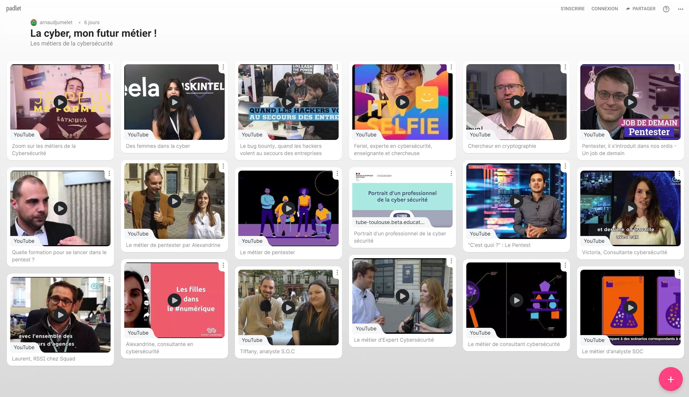
ACTIVITY 2
WHAT DOES YOUR JOB INVOLVE?
How did you get into cybersecurity?
What do you like about your job?
What is a typical day in cybersecurity like?
Do you need to speak English to do your job?
Have you ever been a victim of a virus or phishing attack?
What are your three cybersecurity tips?
What would you say to young people who are hesitating to get into cybersecurity?

Slide 26

ACTIVITY 2
SHAKING UP PRECONCEIVED IDEAS ABOUT THE CYBERSECURITY PROFESSION

Slide 27
ACTIVITY 2
TRUE OR FALSE?
IT’S A SECTOR THAT RECRUITS A LOT

Slide 28
ACTIVITY 2
TRUE OR FALSE?
TRUE
IT’S A SECTOR THAT RECRUITS A LOT
Yes, the cybersecurity sector is recruiting a lot and around the world. There is a shortage of talent in the cybersecurity field with several million vacancies worldwide.

Slide 29
ACTIVITY 2
TRUE OR FALSE?
TO WORK IN CYBERSECURITY YOU NEED TO BE AN ENGINEER

Slide 30
ACTIVITY 2
TRUE OR FALSE?
FALSE
TO WORK IN CYBERSECURITY YOU NEED TO BE AN ENGINEER
No, working in cybersecurity does not necessarily mean being an engineer. There are also non-technical jobs, such as awareness-raising and all the cybersecurity jobs involving commercial and legal aspects.

Slide 31
ACTIVITY 2
TRUE OR FALSE?
CYBERSECURITY MEANS BEING GOOD AT MATH

Slide 32
ACTIVITY 2
TRUE OR FALSE?
FALSE
CYBERSECURITY MEANS BEING GOOD AT MATH
Cybersecurity is all about common sense, critical thinking and knowledge. This does not mean that you should not be good at maths!

Slide 33
ACTIVITY 2
TRUE OR FALSE?
THESE ARE JOBS WHERE YOU HAVE TO KNOW HOW TO CODE

Slide 34
ACTIVITY 2
FALSE
TRUE OR FALSE?
THESE ARE JOBS WHERE YOU HAVE TO KNOW HOW TO CODE
Cybersecurity encompasses many fields, and it is therefore difficult to give a general answer. Some cybersecurity jobs do require the ability to code, such as security solutions developer or technical security auditor. Others, on the other hand, do not, such as cybersecurity consultant or Information Systems Security Manager (ISSM).

Slide 35
ACTIVITY 2
TRUE OR FALSE?
THESE ARE NOT JOBS
FOR WOMEN

Slide 36
ACTIVITY 2
FALSE
TRUE OR FALSE?
THESE ARE NOT JOBS
FOR WOMEN
There is no reason why cybersecurity jobs should not be for women. Cybersecurity jobs are open to women, but they are often underrepresented in this industry.

Slide 37
ACTIVITY 2
TRUE OR FALSE?
YOU DON'T NEED TO STUDY A LONG CAREER

Slide 38
ACTIVITY 2
TRUE
TRUE OR FALSE?
YOU DON'T NEED TO STUDY A LONG CAREER
You do not need to study for a long time to work in cyber security, but it is important to have a good understanding of the basic concepts of computer security.

Slide 39
ACTIVITY 2
TRUE OR FALSE?
CYBERSECURITY JOBS ARE NOT WELL PAID

Slide 40
ACTIVITY 2
FALSE
TRUE OR FALSE?
CYBERSECURITY JOBS ARE NOT WELL PAID
Cybersecurity jobs are rather well paid. They pay an average of $105,800 per year. (Source)

Slide 41

ACTIVITY 2
TO REMEMBER:
CYBERSECURITY JOBS ARE AVAILABLE TO EVERYONE!

Slide 42

ACTIVITY 3
CYBER, A SINGLE JOB OR MULTIPLE JOBS?

Slide 43

ACTIVITY 3
PREVENT OR CURE?

Slide 44
PREVENT
Research | Design Raise awareness | Manage
ACTIVITY 3
CURE
React | Investigate Improve | Rebuild
ETHICAL
HACKER
(From the grouping of name "Prevent and Cure",
from the book: Envie de Cyber, ISSA France Security Tuesday, Ed. Studyrama)

Slide 45
PREVENT
Research | Design Raise awareness | Manage
ACTIVITY 3
CURE
React | Investigate Improve | Rebuild
ETHICAL HACKER
CYBERSECURITY
CONSULTANT
(From the grouping of name "Prevent and Cure",
from the book: Envie de Cyber, ISSA France Security Tuesday, Ed. Studyrama)

Slide 46
ACTIVITY 3
PREVENT
Research | Design Raise awareness | Manage
CURE
React | Investigate Improve | Rebuild
ETHICAL HACKER
CYBERSECURITY CONSULTANT
CYBERSECURITY CONSULTANT
INCIDENT RESPONSE ANALYST
(From the grouping of name "Prevent and Cure",
from the book: Envie de Cyber, ISSA France Security Tuesday, Ed. Studyrama)

Slide 47
ACTIVITY 3
PREVENT
Research | Design Raise awareness | Manage
CURE
React | Investigate Improve | Rebuild
ETHICAL HACKER
CYBERSECURITY CONSULTANT
CYBERSECURITYCONSULTANT
INCIDENT RESPONSE ANALYST
DATA PROTECTION OFFICER
(From the grouping of name "Prevent and Cure",
from the book: Envie de Cyber, ISSA France Security Tuesday, Ed. Studyrama)

Slide 48
ACTIVITY 3
PREVENT
Research | Design Raise awareness | Manage
CURE
React | Investigate Improve | Rebuild
ETHICAL HACKER
CYBERSECURITY CONSULTANT
DATA PROTECTION OFFICER
CYBERSECURITYCONSULTANT
INCIDENT RESPONSE ANALYST
DATA PROTECTION OFFICER
CYBERSECURITY CRISIS MANAGER
(From the grouping of name "Prevent and Cure",
from the book: Envie de Cyber, ISSA France Security Tuesday, Ed. Studyrama)

Slide 49
ACTIVITY 3
PREVENT
Research | Design Raise awareness | Manage
CURE
React | Investigate Improve | Rebuild
ETHICAL HACKER
CYBERSECURITY CONSULTANT
DATA PROTECTION OFFICER
CYBERSECURITY CONSULTANT
INCIDENT RESPONSE ANALYST
DATA PROTECTION OFFICER
CYBERSECURITY CRISIS MANAGER
CRYPTOLOGIST
(From the grouping of name "Prevent and Cure",
from the book: Envie de Cyber, ISSA France Security Tuesday, Ed. Studyrama)

Slide 50
ACTIVITY 3
PREVENT
Research | Design Raise awareness | Manage
CURE
React | Investigate Improve | Rebuild
ETHICAL HACKER
CYBERSECURITY CONSULTANT
DATA PROTECTION OFFICER
CRYPTOLOGIST
CYBERSECURITY CONSULTANT
INCIDENT RESPONSE ANALYST
DATA PROTECTION OFFICER
CYBERSECURITY CRISIS MANAGER
SECURITY SYSTEMS ADMINISTRATOR
(From the grouping of name "Prevent and Cure",
from the book: Envie de Cyber, ISSA France Security Tuesday, Ed. Studyrama)

Slide 51
ACTIVITY 3
PREVENT
Research | Design Raise awareness | Manage
CURE
React | Investigate Improve | Rebuild
ETHICAL HACKER
CYBERSECURITY CONSULTANT
DATA PROTECTION OFFICER
CRYPTOLOGIST
SECURITY SYSTEMS ADMNISTRATOR
CYBERSECURITY CONSULTANT
INCIDENT RESPONSE ANALYST
DATA PROTECTION OFFICER
CYBERSECURITY CRISIS MANAGER
CYBERSECURITY TRAINER
(From the grouping of name "Prevent and Cure",
from the book: Envie de Cyber, ISSA France Security Tuesday, Ed. Studyrama)

Slide 52
ACTIVITY 3
PREVENT
Research | Design Raise awareness | Manage
CURE
React | Investigate Improve | Rebuild
ETHICAL HACKER
CYBERSECURITY CONSULTANT
DATA PROTECTION OFFICER
CRYPTOLOGIST
SECURITY SYSTEM ADMNISTRATOR
CYBERSECURITY TRAINER
CISO
CYBERSECURITY CONSULTANT
INCIDENT RESPONSE ANALYST
DATA PROTECTION OFFICER
CYBERSECURITY CRISIS MANAGER
INFORMATION SYSTEMS SECURITY OFFICER
(CISO)
(From the grouping of name "Prevent and Cure",
from the book: Envie de Cyber, ISSA France Security Tuesday, Ed. Studyrama)

Slide 53
ACTIVITY 3
PREVENT
Research | Design Raise awareness | Manage
CURE
React | Investigate Improve | Rebuild
ETHICAL HACKER
CYBERSECURITY CONSULTANT
DATA PROTECTION OFFICER
CRYPTOLOGIST
SECURITY SYSTEM ADMNISTRATOR
CYBERSECURITY TRAINER
ISSM
CYBERSECURITY CONSULTANT
INCIDENT RESPONSE ANALYST
DATA PROTECTION OFFICER
CYBERSECURITY CRISIS MANAGER
(From the grouping of name "Prevent and Cure",
from the book: Envie de Cyber, ISSA France Security Tuesday, Ed. Studyrama)

Slide 54
ACTIVITY 3
TO REMEMBER:
CYBERSECURITY JOBS ARE VARIED AND MEANINGFUL

Slide 55



BEWARE OF APPAREANCES
CB

Slide 56
AVOID FAKE TECHNICAL SUPPORT SCAMS
ACTIVITY 1

Slide 57
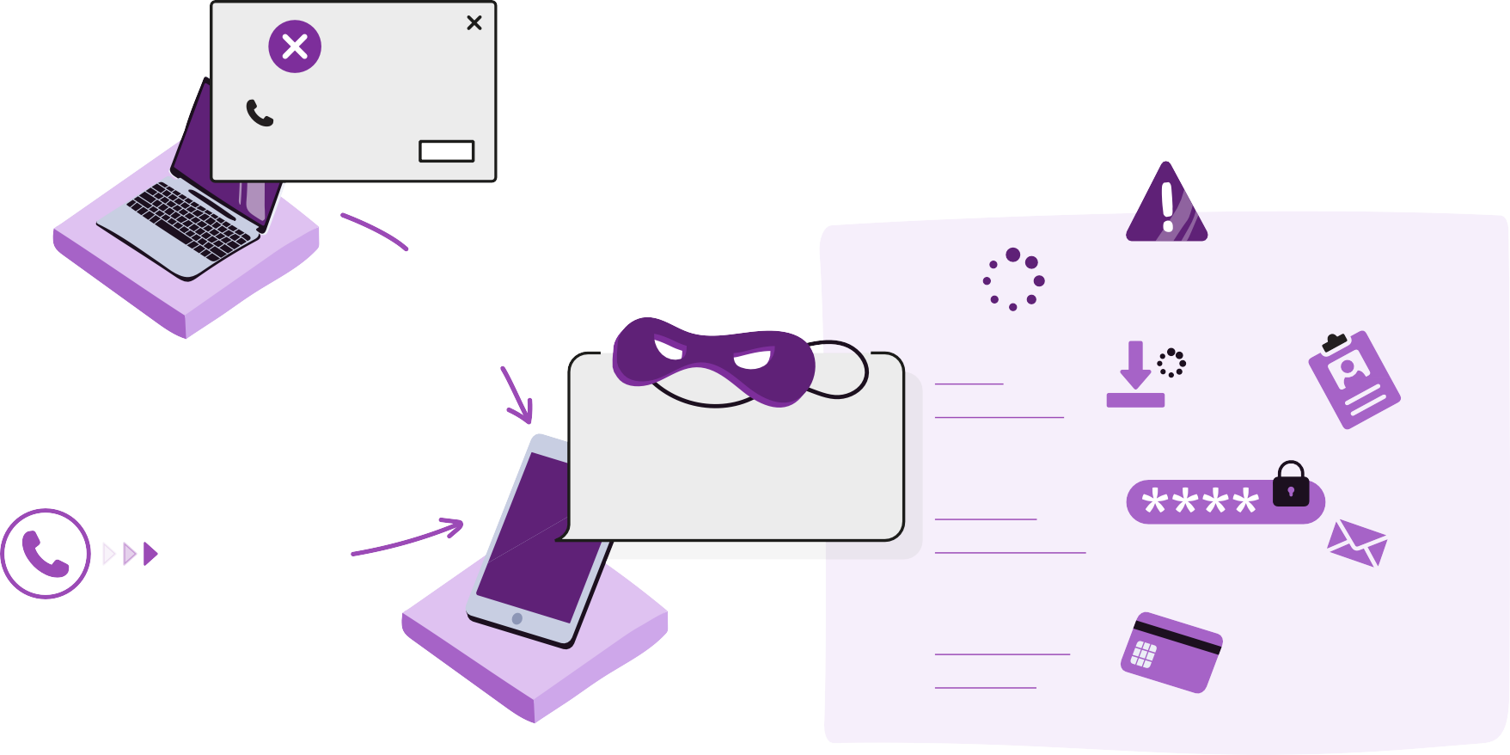
VIRUS
ACTIVITY 1
FAKE ERROR
MESSAGE
CALL QUICKLY!
1 800 751 34
OK
CALL NUMBER
IN THE MEANTIME...
COMPUTER
ACCESS
LOADING VIRUS
INFOS
OR
"LEAVE IT TO ME, I'LL FIX YOUR PROBLEM..."
INCOMING CALL
PERSONAL INFORMATION
REQUEST
NAME
SURNAME
€ +
PAID
SERVICES
+
$

Slide 58
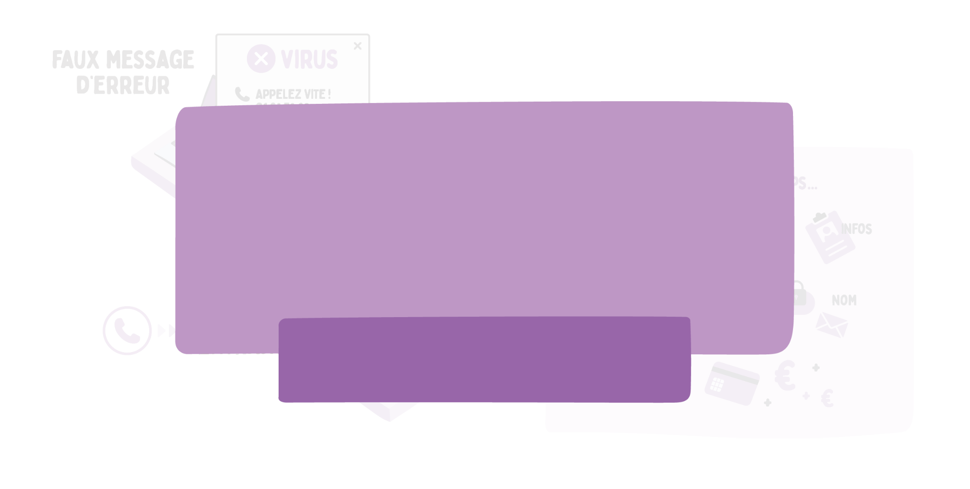
ACTIVITY 1
FOCUS FAKE MICROSOFT SUPPORT
Microsoft will never call you to ask for financial or personal information, or to offer technical support to repair your computer without your request, or to ask you to pay for technical support in the form of cryptocurrency such as Bitcoin or with gift cards.
More information
on cybermalveillance.gouv.fr

Slide 59

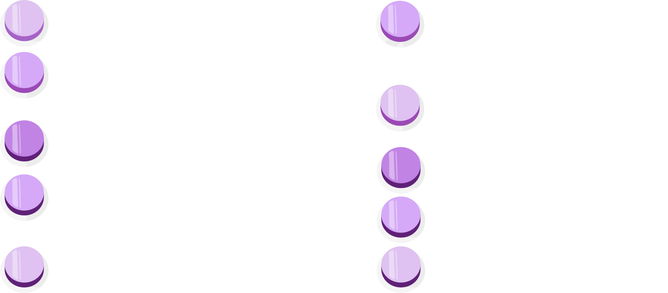
HOW TO REACT IF SOMEONE CALLS YOU OR IF A FAKE ERROR MESSAGE IS DISPLAYED?
ACTIVITY 1
HANG UP
DO NOT PERFORM ANY MANIPULATION ON YOUR DEVICE
DO NOT COMMUNICATE WITH STRANGERS
CALL AN AUTHENTIC NUMBER DIRECTLY
PROTECT YOUR COMPUTER
UPDATE YOUR WEB BROWSER AND OPERATING SYSTEM
ENABLE YOUR POP-UP BLOCKER
CLOSE YOUR BROWSER
RESTART YOUR DEVICE
TALK ABOUT IT

Slide 60


TO REMEMBER:
ACTIVITY 1
REPORT SCAMS TO THE POLICE
DO NOT CLICK ON URGENT MESSAGES THAT APPEAR WHILE YOU ARE ONLINE AND DO NOT DIAL THE NUMBER PROVIDED
HANG UP IF YOU ARE ASKED TO DO SOMETHING ON YOUR COMPUTER
IF YOU COME ACROSS A SCAM, TELL A FRIEND, COLLEAGUE OR FAMILY MEMBER TO MAKE THEM AWARE OF THIS ABOUT THIS THREAT
NEVER DOWNLOAD AN APPLICATION AT THE REQUEST OF SOMEONE YOU DON'T KNOW

Slide 61

ACTIVITY 2
DO NOT LET
CYBERCRIMINALS STEAL FROM YOU

Slide 62

ACTIVITY 2
TO CLICK OR NOT TO CLICK?

Slide 63
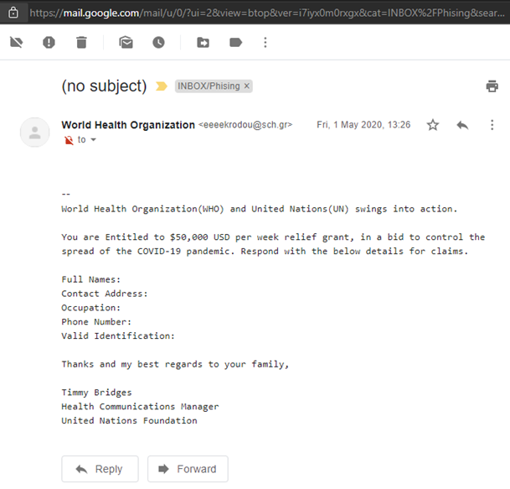
ACTIVITY 2
TO CLICK OR NOT TO CLICK?
NO

Slide 64
ACTIVITY 2
TO CLICK OR NOT TO CLICK?
The email address sending the email does not correspond to the official website address. Also, be careful with e-mails offering money or goods. When it is too good to be true, it’s because it is!
NO

Slide 65
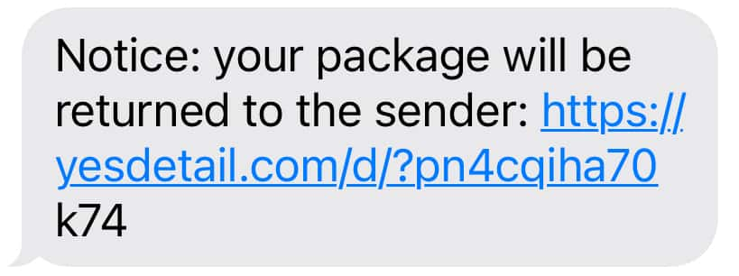
ACTIVITY 2
TO CLICK OR NOT TO CLICK?

Slide 66
ACTIVITY 2
TO CLICK OR NOT TO CLICK?
NO
NO
Beware of messages that require an immediate response or action. There is a good chance that this destination address is a scam, as it does not correspond to the official website address.

Slide 67
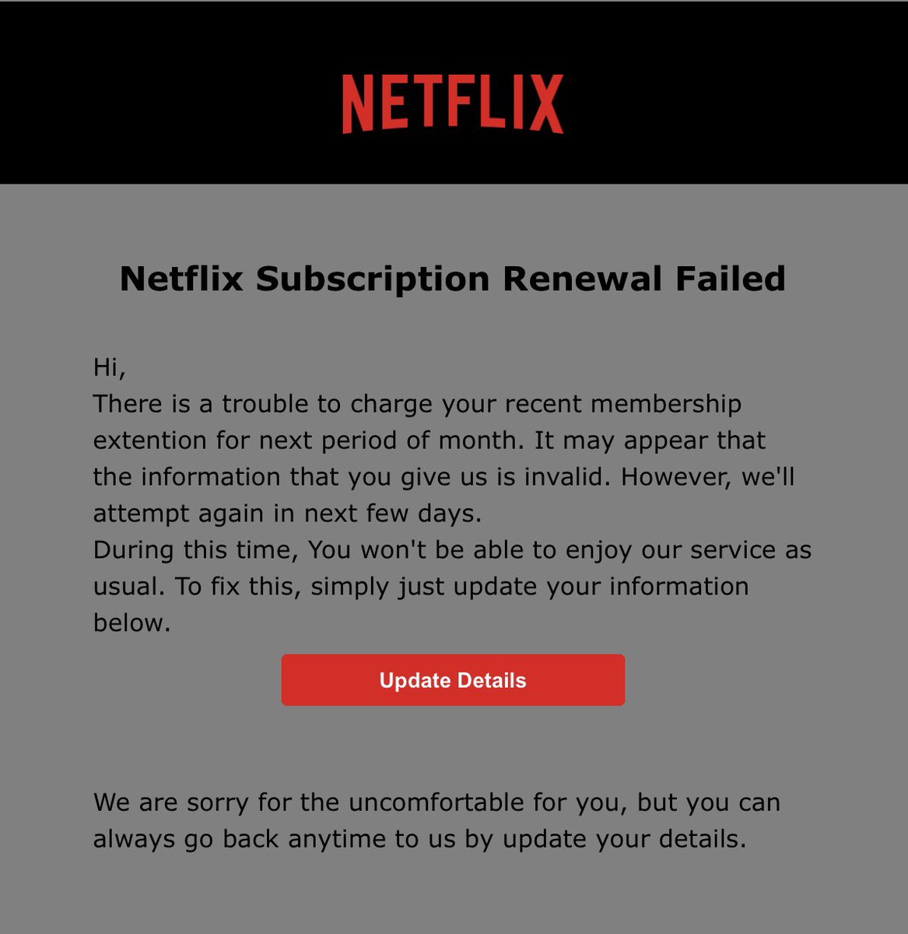

ACTIVITY 2
TO CLICK OR NOT TO CLICK?

Slide 68
ACTIVITY 2
TO CLICK OR NOT TO CLICK?
There is a good chance that this destination address is a scam. It does not correspond to the official website address, and the "http:" link indicates that the connection is not secure, which should make you suspicious.
NO

Slide 69
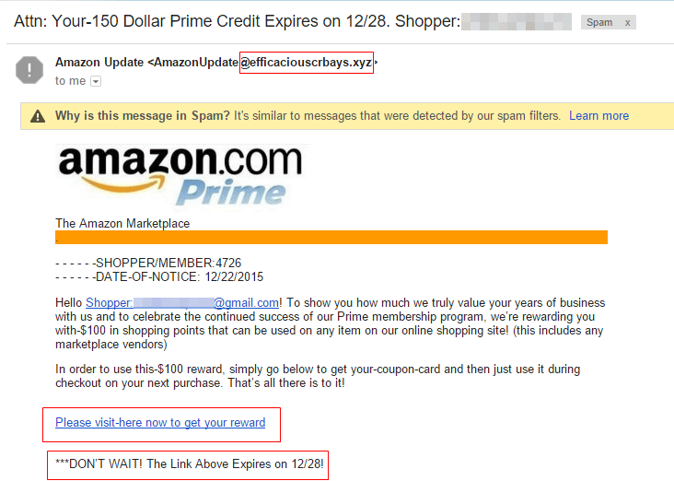
ACTIVITY 2
TO CLICK OR NOT TO CLICK?

Slide 70
ACTIVITY 2
TO CLICK OR NOT TO CLICK?
The email address sending the email does not correspond to the official website address. Beware of messages that require an immediate response or action. Also, be careful with e-mails offering money or goods. When it is too good to be true, it because it is!
NO

Slide 71
ACTIVITY 2
TO CLICK OR NOT TO CLICK?
Microsoft offers you an XBOX One. Congratulations, you’ve won! Get your console: https://www. micrọsoft.com/

Slide 72
ACTIVITY 2
TO CLICK OR NOT TO CLICK?
Microsoft offers you an XBOX One. Congratulations, you’ve won! Get your console: https://www. micrọsoft.com/
NO
The destination domain name is not exactly the same as the to the official website address.
This type of scam is called typosquatting, i.e., using a letter that is graphically close to another one to make people think they are on an official website.
Attention: a small dot appears below the first "o" in the word microsoft.

Slide 73
ACTIVITY 2
YOU HAVE A DOUBT ABOUT THE MESSAGE YOU RECEIVED?
Don't be afraid! You probably don't have anything incriminating to blame yourself for
Do not open links or attachments without being sure of the reliability of the sender
Check the sender's address: contact him through another channel.
Do not respond to any suspicious or blackmail emails to avoid show the sender that you are receptive to the message
Change your passwords, avoid having the same password for each account to protect yourself from cascading attacks and, if possible, activate double authentication on your most sensitive accounts, including your email accounts
Delete the message

Slide 74
AND IF YOU HAVE DISCLOSED YOUR PASSWORD
ACTIVITY 2
AND IF YOU HAVE PAID AND ARE A VICTIM OF A SCAM?
Change passwords for compromised accounts immediately
Contact your bank to try to get the payment reversed
File a complaint with your local authorities
OR PERSONAL INFORMATION?
Immediately change passwords for compromised accounts
Report the scams, by contacting the local authorities
1
2
3
1
2
3
Visit your national platforms or helplines for assistance to victims of cyberbullying for more advice

Slide 75
ACTIVITY 2
HOW TO SPOT A SCAM RECEIVED BY EMAIL OR SMS?

Slide 76
ACTIVITY 2
HOW TO SPOT A SCAM RECEIVED BY EMAIL OR SMS?
BEWARE OF UNKNOWN SENDERS

Slide 77
ACTIVITY 2
HOW TO SPOT A SCAM RECEIVED BY EMAIL OR SMS?
BEWARE OF UNKNOWN SENDERS
PAY ATTENTION TO THE WORDING OF THE EMAIL/TEXT

Slide 78
ACTIVITY 2
HOW TO SPOT A SCAM RECEIVED BY EMAIL OR SMS?
BEWARE OF UNKNOWN SENDERS
PAY ATTENTION TO THE WORDING OF THE EMAIL/TEXT
THE SENDER'S EMAIL ADDRESS IS NOT A RELIABLE CRITERION

Slide 79

ACTIVITY 2
HOW TO SPOT A SCAM RECEIVED BY EMAIL OR SMS?
BEWARE OF UNKNOWN SENDERS
PAY ATTENTION TO THE WORDING OF THE EMAIL/TEXT
THE SENDER'S EMAIL ADDRESS IS NOT A RELIABLE CRITERION
CHECK THE LINKS

Slide 80

ACTIVITY 2
HOW TO SPOT A SCAM RECEIVED BY EMAIL OR SMS?
BEWARE OF UNKNOWN SENDERS
PAY ATTENTION TO THE WORDING OF THE EMAIL/TEXT
THE SENDER'S EMAIL ADDRESS IS NOT A RELIABLE CRITERION
CHECK THE LINKS
BEWARE OF STRANGE, URGENT AND TOO GOOD TO BE TRUE REQUESTS

Slide 81
ACTIVITY 2
CREATE YOUR OWN
SCAM

Slide 82










ACTIVITY 2
New message
To
Subject
SEND

Slide 83

ACTIVITY 2
ONLINE FRAUD IS A CRIMINAL OFFENCE WHICH MAY BE PUNISHED BY JAIL TIME AND PENALTIES

Slide 84


TO REMEMBER:
ACTIVITY 2
REMEMBER THAT IF IT SOUNDS TOO GOOD TO BE TRUE, IT PROBABLY IS!
BEWARE OF MESSAGES THAT REQUIRE YOU TO RESPOND OR TAKE IMMEDIATE ACTION
IF YOU HAVE NOT ENTERED A COMPETITION, YOU CANNOT HAVE WON A PRIZE!
BE CAUTIOUS ABOUT MESSAGES WITH VISUALS THAT LOOK OFFICIAL BUT ARE POORLY DISPLAYED OR HAVE SPELLING MISTAKES
IF IN DOUBT, YOU SHOULD ACCESS THE WEBSITE BY TYPING THE ADDRESS DIRECTLY INTO THE SEARCH BAR
NEVER CLICK ON A LINK OR AN ATTACHMENT WHOSE ORIGIN OR NATURE SEEMS DOUBTFUL
BEFORE INSTALLING AN APPLICATION,
ASK YOURSELF IF YOU REALLY NEED IT!

Slide 85

ACTIVITY 3
LOCATE
THE CONTENTS
DEEPFAKE

Slide 86

ACTIVITY 3
REAL PHOTO OR NOT?

Slide 87
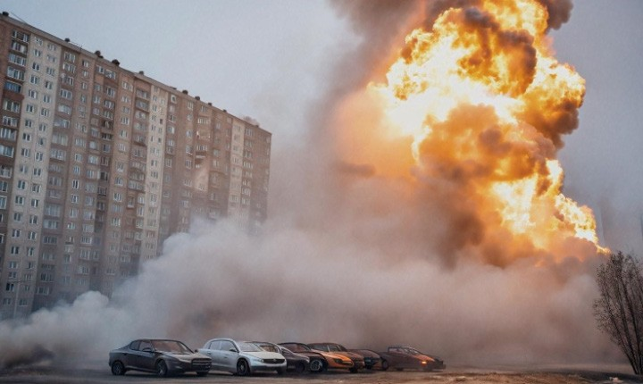
ACTIVITY 3
The increasing quality of AI images makes them harder to spot. Can you tell if this image is real or AI-generated ?

Slide 88
ACTIVITY 3
The increasing quality of AI images makes them harder to spot. Can you tell if this image is real or AI-generated ?
AI

Slide 89
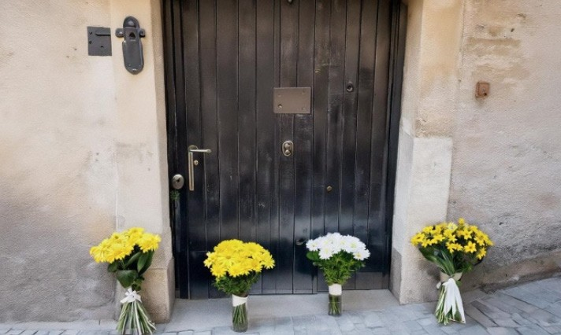
ACTIVITY 3
The increasing quality of AI images makes them harder to spot. Can you tell if this image is real or AI-generated ?

Slide 90
ACTIVITY 3
The increasing quality of AI images makes them harder to spot. Can you tell if this image is real or AI-generated ?
AI

Slide 91
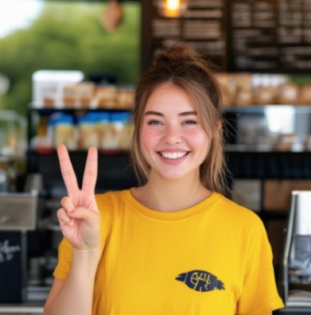
ACTIVITY 3
The increasing quality of AI images makes them harder to spot. Can you tell if this image is real or AI-generated ?

Slide 92
ACTIVITY 3
The increasing quality of AI images makes them harder to spot. Can you tell if this image is real or AI-generated ?
AI

Slide 93

ACTIVITY 3
To extend the quiz, go to:
https://www.realornotquiz.com/

Slide 94
ACTIVITY 3
Look for the 4 signs that this text was generated by an AI:
Hi all! Today, we are going to discuss the importance of saving unicorns in rainforests. Unicorns, these endemic creatures, are in danger of extinction because of deforestation and poaching. If we do nothing, they could disappear by 2025.
It is important to understand that unicorns play a crucial role in the ecosystem. They help pollinate plants and regulate the dragon population. In addition, their magic horn has incredible healing properties.
In addition, modern technology, such as drones and satellites, makes it possible to monitor unicorns in their natural habitat. This helps us protect these precious animals and prevent illegal activities.
In short, it is our duty to protect unicorns and their habitat.
If we work together, we can ensure a better future for these fascinating creatures and our planet.

Slide 95
ACTIVITY 3
Look for the 4 signs that this text was generated by an AI:
FACTUAL INCONSISTENCIES
Hi all! Today, we are going to discuss the importance of saving unicorns in rainforests. Unicorns, these endemic creatures, are in danger of extinction because of deforestation and poaching. If we do nothing, they could disappear by 2025.
It is important to understand that unicorns play a crucial role in the ecosystem. They help pollinate plants and regulate the dragon population. In addition, their magic horn has incredible healing properties.
In addition, modern technology, such as drones and satellites, makes it possible to monitor unicorns in their natural habitat. This helps us protect these precious animals and prevent illegal activities.
In short, it is our duty to protect unicorns and their habitat.
If we work together, we can ensure a better future for these fascinating creatures and our planet.

Slide 96
ACTIVITY 3
Look for the 4 signs that this text was generated by an AI:
INCONSISTENT TRANSITIONS
Hi all! Today, we are going to discuss the importance of saving unicorns in rainforests. Unicorns, these endemic creatures, are in danger of extinction because of deforestation and poaching. If we do nothing, they could disappear by 2025.
It is important to understand that unicorns play a crucial role in the ecosystem. They help pollinate plants and regulate the dragon population. In addition, their magic horn has incredible healing properties.
………………
In addition, modern technology, such as drones and satellites, makes it possible to monitor unicorns in their natural habitat. This helps us protect these precious animals and prevent illegal activities.
…………
In short, it is our duty to protect unicorns and their habitat.
If we work together, we can ensure a better future for these fascinating creatures and our planet.

Slide 97
ACTIVITY 3
Look for the 4 signs that this text was generated by an AI:
ABSENCE OF SOURCES
Hi all! Today, we are going to discuss the importance of saving unicorns in rainforests. Unicorns, these endemic creatures, are in danger of extinction because of deforestation and poaching. If we do nothing, they could disappear by 2025. ?
It is important to understand that unicorns play a crucial role in the ecosystem. They help pollinate plants and regulate the dragon population. In addition, their magic horn has incredible healing properties.
In addition, modern technology, such as drones and satellites, makes it possible to monitor unicorns in their natural habitat. This helps us protect these precious animals and prevent illegal activities.
In short, it is our duty to protect unicorns and their habitat.
If we work together, we can ensure a better future for these fascinating creatures and our planet.

Slide 98
ACTIVITY 3
Look for the 4 signs that this text was generated by an AI:
PUNCTUATION ERRORS AND TURN OF PHRASE
Hi all! Today, we are going to discuss the importance of saving unicorns in rainforests. Unicorns, these endemic creatures, are in danger of extinction because of deforestation and poaching. If we do nothing, they could disappear by 2025.
It is important to understand that unicorns play a crucial role in the ecosystem. They help pollinate plants and regulate the dragon population. In addition, their magic horn has incredible healing properties.
In addition, modern technology, such as drones and satellites, makes it possible to monitor unicorns in their natural habitat. This helps us protect these precious animals and prevent illegal activities.
In short, it is our duty to protect unicorns and their habitat.
If we work together, we can ensure a better future for these fascinating creatures and our planet.

Slide 99
ACTIVITY 3
TO REMEMBER :
What can we do to combat deepfakes?
CHECK FOR ACCURACY BEFORE SHARING OR COMMENTING.
IF A TITLE, VIDEO, IMAGE, OR AUDIO RECORDING SOUNDS SENSATIONAL, BE SURE TO READ THE FULL STORY
AND TO VERIFY ITS SOURCE BEFORE SHARING ITS CONTENT.
THE BEST WAY TO STOP THE SPREAD OF A DEEPFAKE IS TO AVOID SHARING OR COMMENTING ON IT FURTHER.

Slide 100
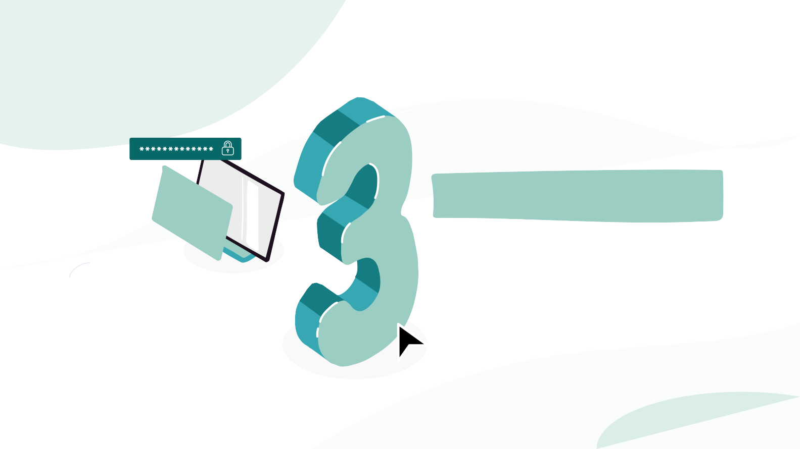
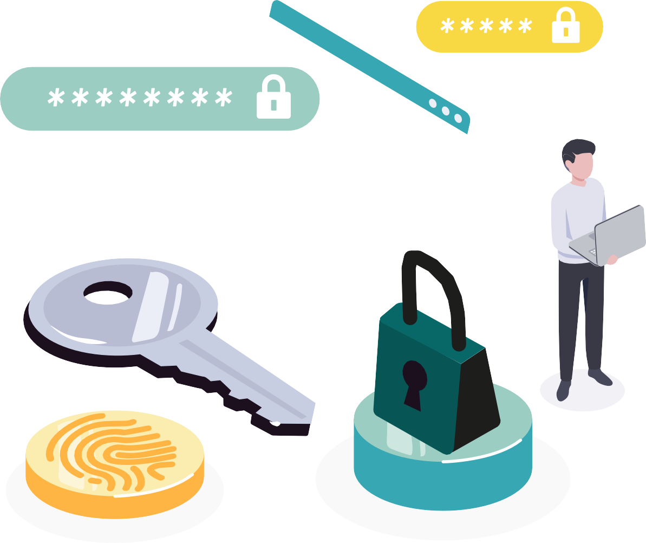

PROTECT
YOUR ACCOUNTS ONLINE

Slide 101

ACTIVITY 1
A STRONG PASSWORD,
IS YOUR BEST DEFENCE

Slide 102











WHAT ARE THE RISKS OF USING THE SAME PASSWORD EVERYWHERE?
ACTIVITY 1
A HACKER COULD:
Steal your identity
Hack into your bank details and make fraudulent purchases
CHOOSE A PASSWORD THAT IS
Steal your contacts by hacking into your mailboxes/social networks
Blackmail you and demand a ransom
(in case of compromising data)
DIFFERENT
FOR EACH ACCOUNT

Slide 103
CREATE A STRONG PASSWORD
ACTIVITY 1

Slide 104

ACTIVITY 1
CREATE A STRONG PASSWORD
COMPLETE
contains at least 14 characters and 4 different types: lower case, upper case, numbers and special characters (!,?, €, #...)

Slide 105
ACTIVITY 1
CREATE A STRONG PASSWORD
COMPLETE
contains at least 14 characters and 4 different types: lower case, upper case, numbers and special characters (!,?, €, #...)
SAYS NOTHING ABOUT YOU

Slide 106
ACTIVITY 1
CREATE A STRONG PASSWORD
COMPLETE
contains at least 14 characters and 4 different types: lower case, upper case, numbers and special characters (!,?, €, #...)
SAYS NOTHING ABOUT YOU
UNIQUE

Slide 107
ACTIVITY 1
2 TIPS:
I am not a hacker & yet I work in cybersecurity!
Ianah&yIwic!
Swan*Edge*Door!Work
PASSPHRASE
COMBINED WORDS

Slide 108
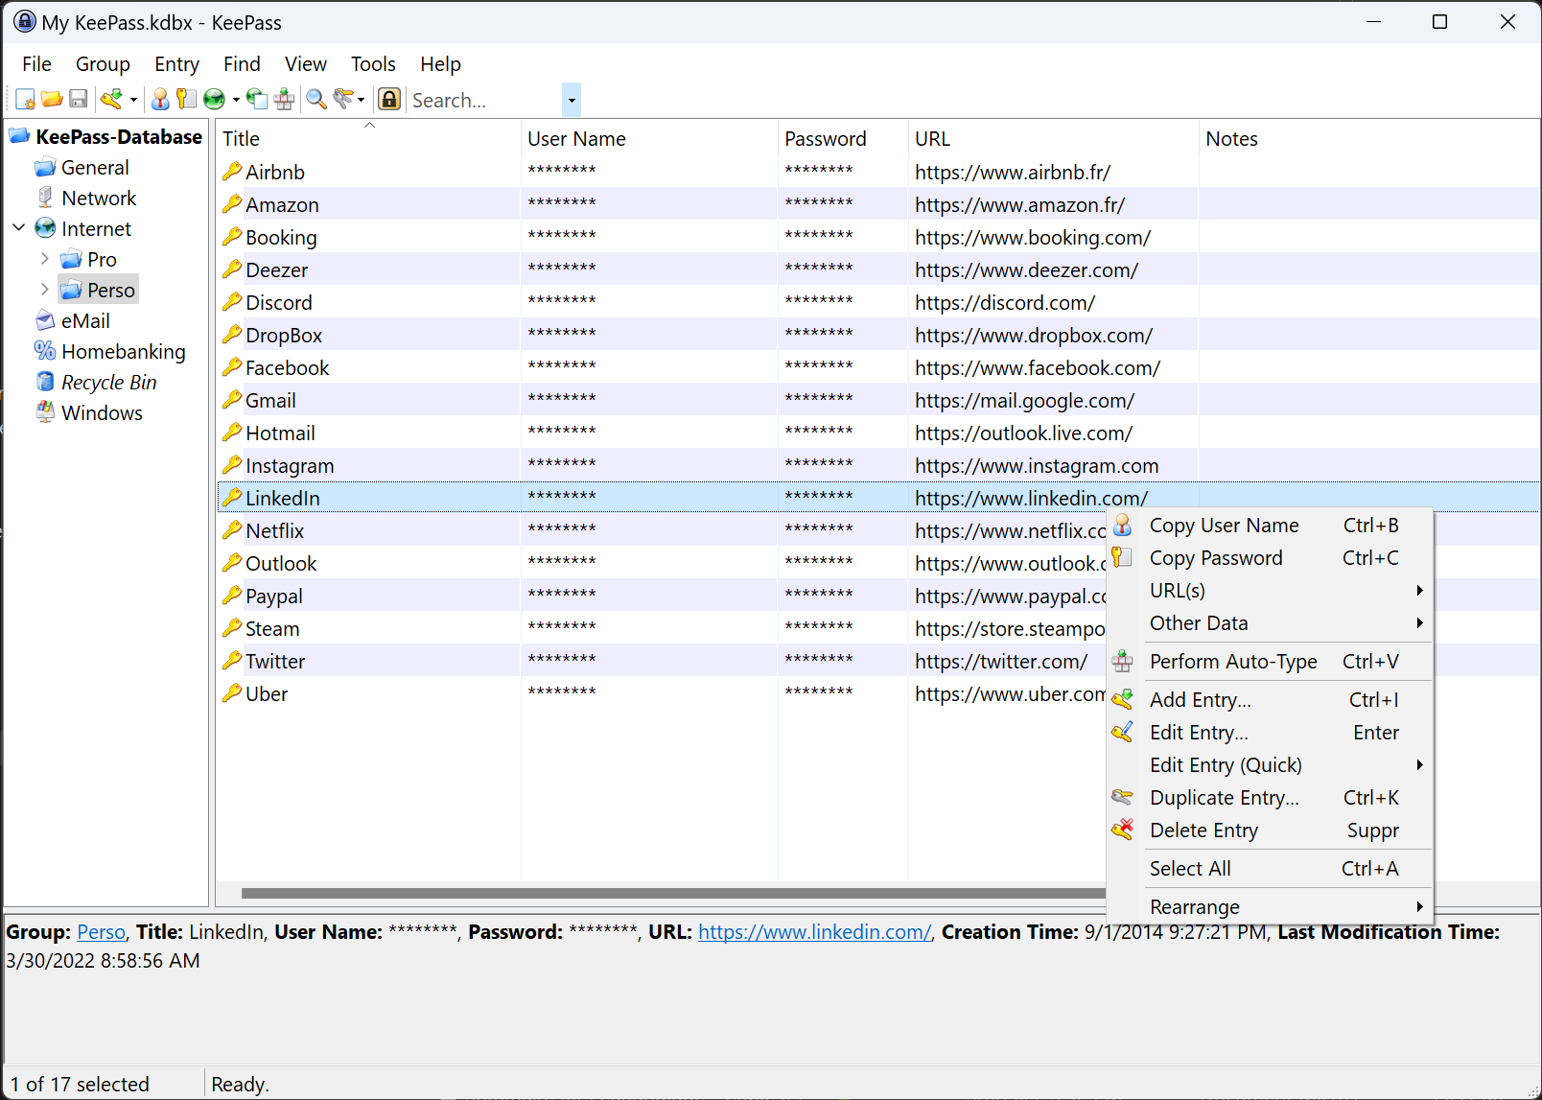


USE A PASSWORD MANAGER
ACTIVITY 1
PASSWORDSAFE ZENYWAY
KEEPASS

Slide 109
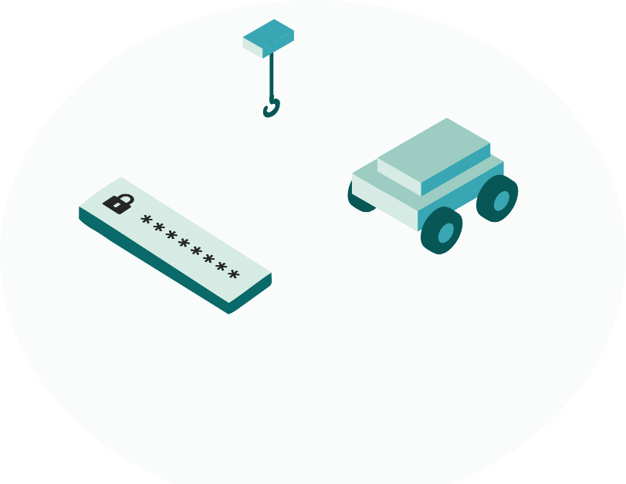
ACTIVITY 1
WHAT IS A PASSWORD MANAGER?

Slide 110
ACTIVITY 1
WHAT IS A PASSWORD MANAGER?
It is a tool for storing and securing usernames and passwords.

Slide 111
ACTIVITY 1
WHAT IS A PASSWORD MANAGER?
It is a tool for storing and securing usernames and passwords.
It can be on-premises or synced to the cloud. There are managers built into web browsers.

Slide 112
ACTIVITY 1
WHAT IS A PASSWORD MANAGER?
It is a tool for storing and securing usernames and passwords.
It can be on-premises or synced to the cloud. There are managers built into web browsers.
It generates strong and unique passwords for each service, and allows for autofill of logins on websites and apps.

Slide 113
ACTIVITY 1
WHAT IS A PASSWORD MANAGER?
It is a tool for storing and securing usernames and passwords.
It can be on-premises or synced to the cloud. There are managers built into web browsers.
It generates strong and unique passwords for each service, and allows for autofill of logins on websites and apps.
Some offer biometric authentication (e.g. Face ID, Touch ID) and a built-in security audit to check if passwords have been compromised.

Slide 114

ACTIVITY 1
FOCUS ON KEEPASS: A FREE AND SECURE MANAGER

Slide 115
ACTIVITY 1
FOCUS ON KEEPASS: A FREE AND SECURE MANAGER
WHAT FOR?

Slide 116
ACTIVITY 1
FOCUS ON KEEPASS: A FREE AND SECURE MANAGER
WHAT FOR?
It is a free and open source tool.

Slide 117
FOCUS ON KEEPASS: A FREE AND SECURE MANAGER
WHAT FOR?
It is a free and open source tool.
It is customizable and can be synchronized (via a secure cloud if desired, such as OneDrive, Google Drive, etc.).

Slide 118
ACTIVITY 1
FOCUS ON KEEPASS: A FREE AND SECURE MANAGER
WHAT FOR?
It is a free and open source tool.
It is customizable and can be synchronized (via a secure cloud if desired, such as OneDrive, Google Drive, etc.).
The CNIL recommends the use of KeePass in its best practice guides.

Slide 119
ACTIVITY 1
FOCUS ON KEEPASS: A FREE AND SECURE MANAGER
WHAT FOR?
HOW?
It is a free and open source tool.
It is customizable and can be synchronized (via a secure cloud if desired, such as OneDrive, Google Drive, etc.).
The CNIL recommends the use of KeePass in its best practice guides.

Slide 120
ACTIVITY 1
FOCUS ON KEEPASS: A FREE AND SECURE MANAGER
WHAT FOR?
HOW?
It is a free and open source tool.
It is customizable and can be synchronized (via a secure cloud if desired, such as OneDrive, Google Drive, etc.).
The CNIL recommends the use of KeePass in its best practice guides.
Securely stores passwords, IDs, sensitive notes, etc.

Slide 121
ACTIVITY 1
FOCUS ON KEEPASS: A FREE AND SECURE MANAGER
WHAT FOR?
HOW?
It is a free and open source tool.
It is customizable and can be synchronized (via a secure cloud if desired, such as OneDrive, Google Drive, etc.).
The CNIL recommends the use of KeePass in its best practice guides.
Securely stores passwords, IDs, sensitive notes, etc.
Encrypts data with a master password.

Slide 122
ACTIVITY 1
FOCUS ON KEEPASS: A FREE AND SECURE MANAGER
WHAT FOR?
HOW?
It is a free and open source tool.
It is customizable and can be synchronized (via a secure cloud if desired, such as OneDrive, Google Drive, etc.).
The CNIL recommends the use of KeePass in its best practice guides.
Securely stores passwords, IDs, sensitive notes, etc.
Encrypts data with a master password.
Generates strong passwords and OTPs (one-time codes for 2FA)

Slide 123
ACTIVITY 1
FOCUS ON KEEPASS: A FREE AND SECURE MANAGER
WHAT FOR?
HOW?
It is a free and open source tool.
It is customizable and can be synchronized (via a secure cloud if desired, such as OneDrive, Google Drive, etc.).
The CNIL recommends the use of KeePass in its best practice guides.
Securely stores passwords, IDs, sensitive notes, etc.
Encrypts data with a master password.
Generates strong passwords and OTPs (one-time codes for 2FA)
Compatible on several platforms for example: Windows, iOS (KeePassium), Android (KeePass2Android)

Slide 124
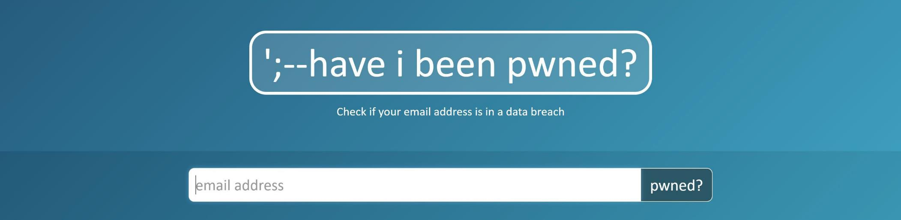
IS YOUR PASSWORD COMPROMISED?
ACTIVITY 1

Slide 125

TO REMEMBER:
ACTIVITY 1
SECURE ACCOUNTS AND DEVICES WITH STRONG PASSWORDS OR PASSPHRASES
ENSURE THAT PASSWORDS OR PASSPHRASES ARE UNIQUE FOR EACH ACCOUNT AND DEVICE

Slide 126

ACTIVITY 2
PROTECT
YOUR MOST IMPORTANT ONLINE ACCOUNTS

Slide 127
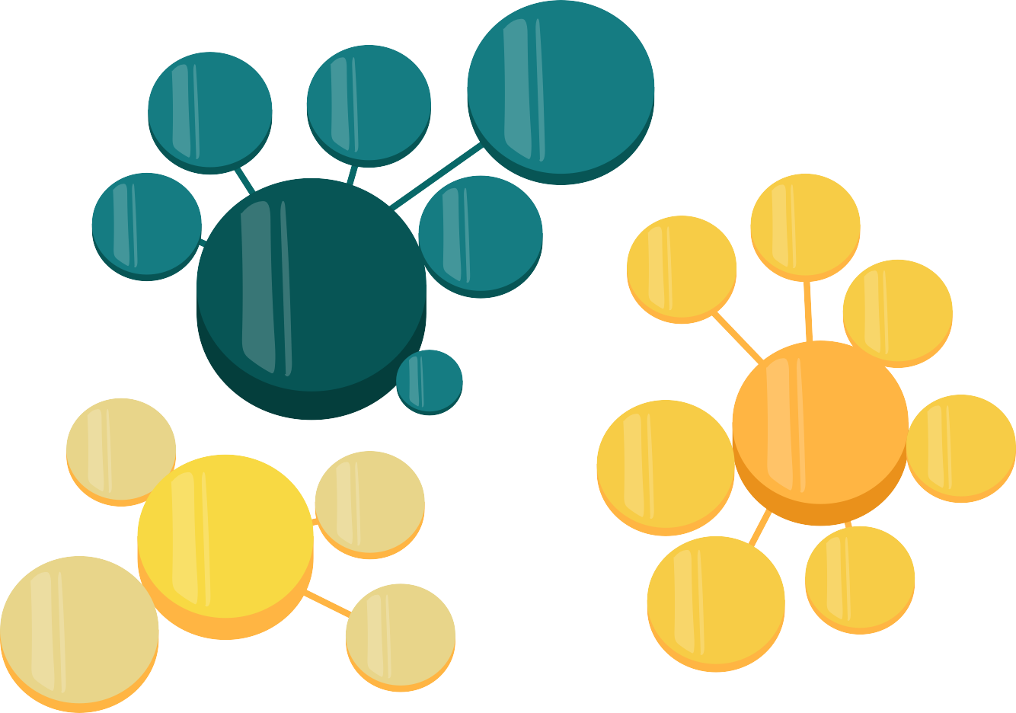


ADMINISTRATION TAXES INSURANCE...
HOMEWORK
PICTURES STORAGE
WEBSITES
CONTACT
LIST
CONTACT
LIST
DOCUMENT STORAGE
ONLINE
GAMES
MAILBOX
FOR SCHOOLS
PERSONAL
MAILBOX
CAR SHARING
FRIENDS LIST
IBAN
SOCIAL NETWORK IDENTITY
PASSWORDS
INSTANT MESSAGES
PHOTOS
WORK MAILBOX
CONTACTLIST
MUSIC
PLATFORMS
VIDEOS
CONFIDENTIAL
HR INFO
MAIL&DOC

Slide 128
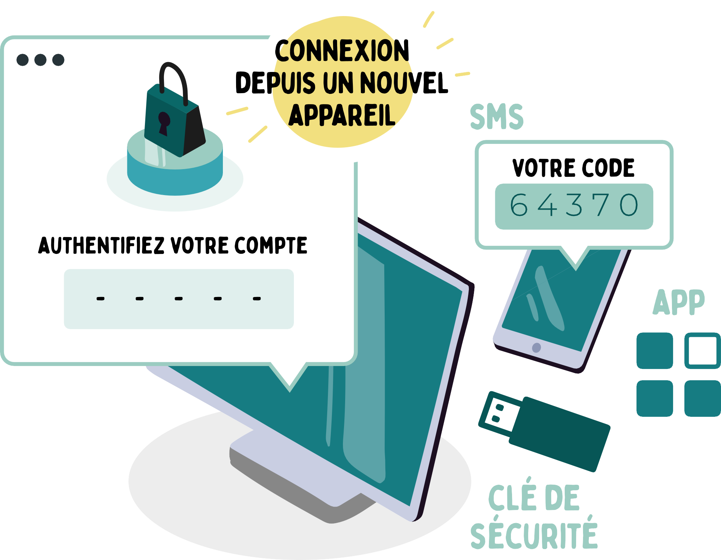
HOW DOES TWO-FACTOR AUTHENTICATION WORK?
ACTIVITY 2
CONNECTION FROM A NEW DEVICE
TEXT
SOME SERVICES OFFERING TWO-FACTOR AUTHENTICATION
Gmail, Outlook/Hotmail, Yahoo Mail...
Facebook, Instagram, LinkedIn, Snapchat, TikTok, Twitter/X...
Teams, WhatsApp, Zoom…
Amazon, eBay, Paypal…
Apple iCloud, Dropbox, Google Drive,
OneDrive…
IF YOU USE ONE OF THESE SERVICES, ACTIVATE TWO-FACTOR AUTHENTICATION!
YOUR CODE
AUTHENTICATE YOUR ACCOUNT
SECURITY
KEY

Slide 129
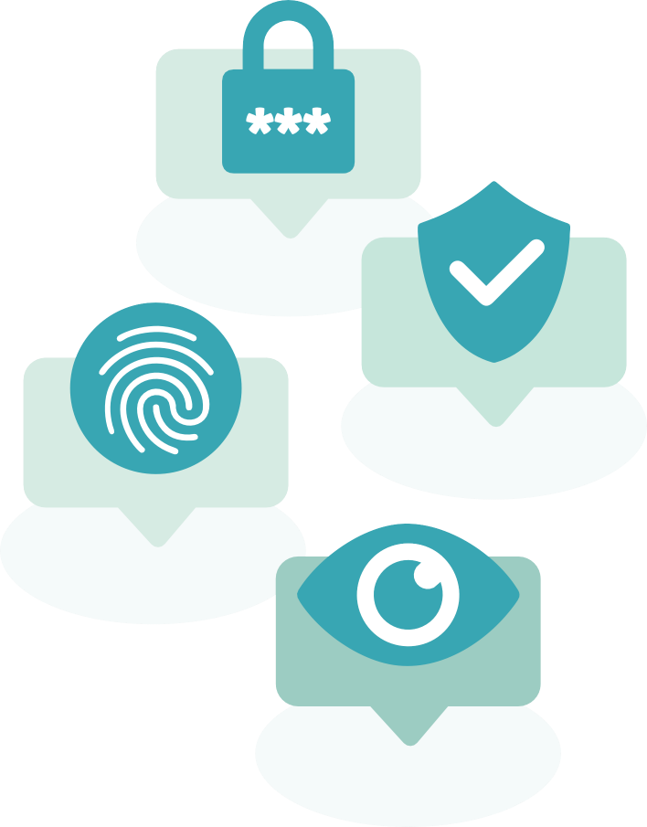
ACTIVITY 2
MULTI-FACTOR AUTHENTICATION (MFA)

Slide 130
ACTIVITY 2
MULTI-FACTOR AUTHENTICATION (MFA)
It is a security mechanism that requires multiple forms of authentication to access an account or service.

Slide 131
ACTIVITY 2
MULTI-FACTOR AUTHENTICATION (MFA)
It is a security mechanism that requires multiple forms of authentication to access an account or service.
MFA is used by many platforms like Facebook, Instagram, Twitter/X, Google, Amazon, and Outlook.

Slide 132
ACTIVITY 2
MULTI-FACTOR AUTHENTICATION (MFA)
It is a security mechanism that requires multiple forms of authentication to access an account or service.
MFA is used by many platforms like Facebook, Instagram, Twitter/X, Google, Amazon, and Outlook.
MFA strengthens digital identity by requiring multiple verifications, reducing the risk of spoofing.

Slide 133


ACTIVITY 2
What MFA am I?

Slide 134
ACTIVITY 2
WHAT MFA AM I?
WHAT I AM

Slide 135
ACTIVITY 2
WHAT MFA AM I?
WHAT I AM
WHAT I KNOW

Slide 136
ACTIVITY 2
WHAT MFA AM I?
WHAT I AM
WHAT I KNOW
WHAT I HAVE

Slide 137
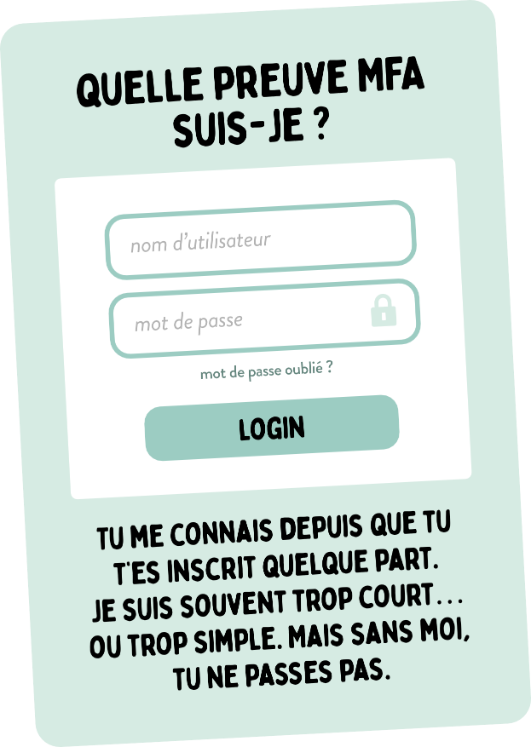
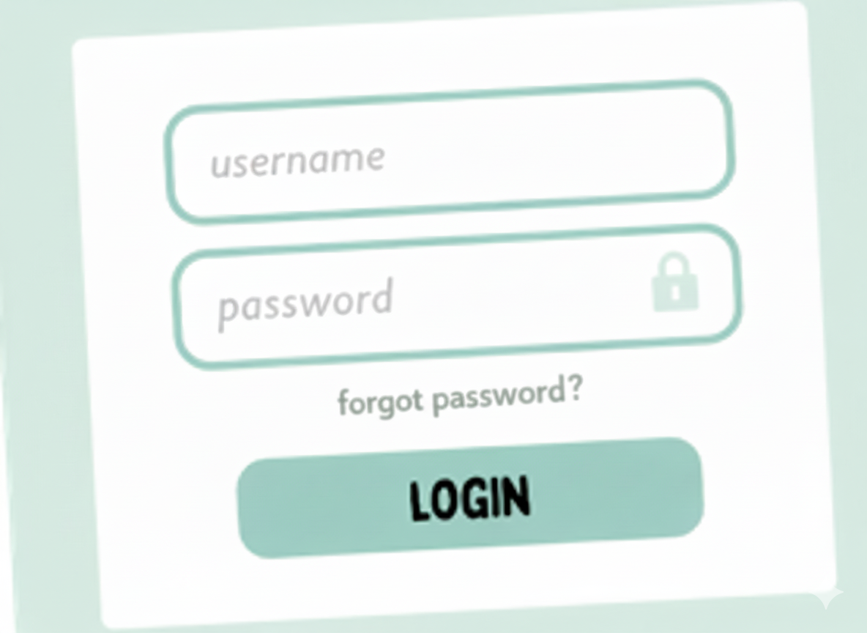
ACTIVITY 2
WHAT MFA PROOF AM I?
WHAT I AM
WHAT I KNOW
YOU’VE KNOWN ME SINCE YOU SIGNED UP SOMEWHERE. I’M OFTEN TOO SHORT… OR TOO SIMPLE. BUT WITHOUT ME, YOU CAN’T GET THROUGH.
WHAT I HAVE

Slide 138
ACTIVITY 2
WHAT MFA PROOF AM I?
WHAT I AM
WHAT I KNOW
YOU’VE KNOWN ME SINCE YOU SIGNED UP SOMEWHERE. I’M OFTEN TOO SHORT… OR TOO SIMPLE. BUT WITHOUT ME, YOU CAN’T GET THROUGH.
WHAT I HAVE

Slide 139
ACTIVITY 2
WHAT MFA PROOF AM I?
WHAT I KNOW
Information known only to the user, used to authenticate themselves, such as a password, a PIN code or the answer to a secret question.
^{Easy to set up}
^{Universally understood}
^{No technology required}
^{Can be forgotten}
^{Often weak} ^{or reused}
^{Can be stolen} ^{(phishing,} ^{data leakage, etc.)}
YOU’VE KNOWN ME SINCE YOU SIGNED UP SOMEWHERE. I’M OFTEN TOO SHORT… OR TOO SIMPLE. BUT WITHOUT ME, YOU CAN’T GET THROUGH.

Slide 140
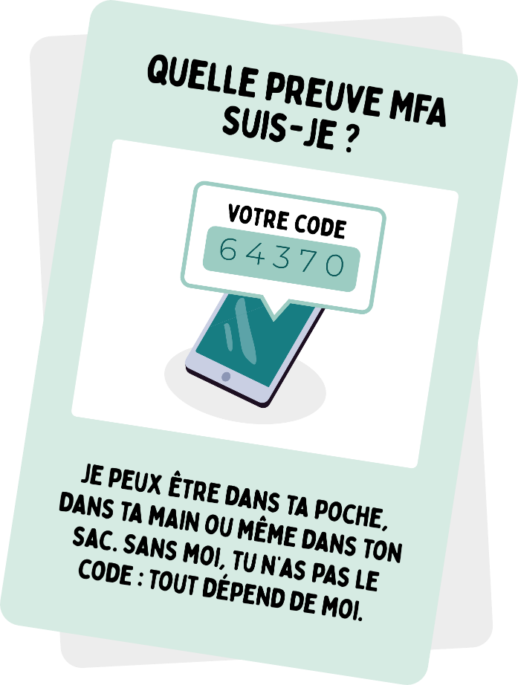
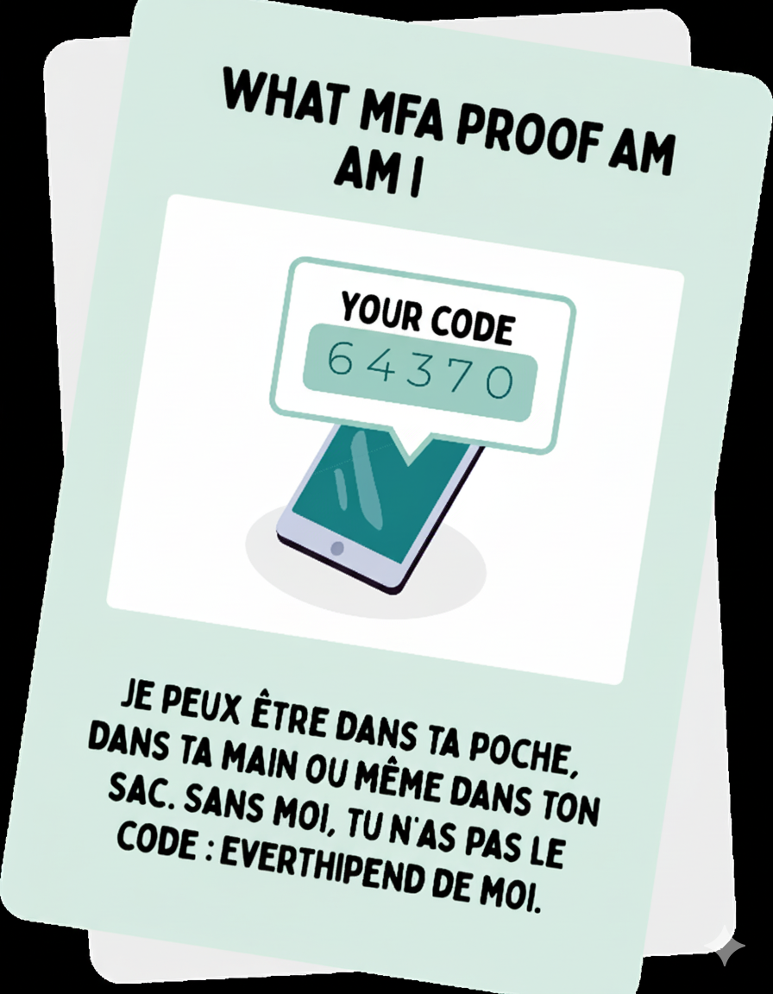
ACTIVITY 2
WHAT MFA PROOF AM I?
WHAT I AM
WHAT I KNOW
YOU’VE KNOWN ME SINCE YOU SIGNED UP SOMEWHERE. I’M OFTEN TOO SHORT… OR TOO SIMPLE. BUT WITHOUT ME, YOU CAN’T GET THROUGH.
I CAN BE IN YOUR POCKET, IN YOUR HAND, OR EVEN IN YOUR BAG. WITHOUT ME, YOU DON’T HAVE THE CODE: EVERYTHING DEPENDS ON ME.
WHAT I HAVE

Slide 141
ACTIVITY 2
WHAT MFA PROOF AM I?
WHAT I AM
WHAT I KNOW
I CAN BE IN YOUR POCKET, IN YOUR HAND, OR EVEN IN YOUR BAG. WITHOUT ME, YOU DON’T HAVE THE CODE: EVERYTHING DEPENDS ON ME.
WHAT I HAVE

Slide 142
ACTIVITY 2
WHAT MFA PROOF AM I?
WHAT I HAVE
^{A physical or digital object} that the user owns and that allows them ^{to prove their identity.}
Loss or theft of the object = blocked access
Depends on the physical state of the object (battery, breakage...)
Can be intercepted (e.g. cloned SIM card)
Difficult to guess from a distance
Can be easily combined with other factors
More secure than a password alone
I CAN BE IN YOUR POCKET, IN YOUR HAND, OR EVEN IN YOUR BAG. WITHOUT ME, YOU DON’T HAVE THE CODE: EVERYTHING DEPENDS ON ME.

Slide 143
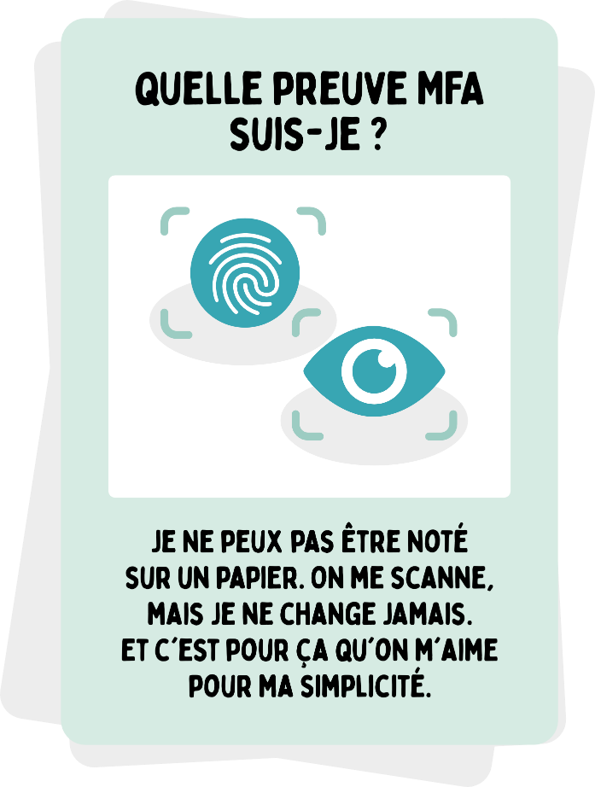
ACTIVITY 2
WHAT MFA PROOF AM I?
WHAT I AM
WHAT I KNOW
I CAN’T BE WRITTEN DOWN ON PAPER. I’M SCANNED, BUT I NEVER CHANGE. AND THAT’S WHY PEOPLE LOVE ME FOR MY SIMPLICITY.
WHAT I HAVE

Slide 144
ACTIVITY 2
WHAT MFA PROOF AM I?
WHAT I AM
WHAT I KNOW
I CAN’T BE WRITTEN DOWN ON PAPER. I’M SCANNED, BUT I NEVER CHANGE. AND THAT’S WHY PEOPLE LOVE ME FOR MY SIMPLICITY.
WHAT I HAVE

Slide 145
ACTIVITY 2
WHAT MFA PROOF AM I?
WHAT I AM
A unique biological characteristic of the user (physical identity).
Cannot be changed in the event of a leak or hack
Can malfunction depending on the conditions (light, sensor, injury...)
I CAN’T BE WRITTEN DOWN ON PAPER. I’M SCANNED, BUT I NEVER CHANGE. AND THAT’S WHY PEOPLE LOVE ME FOR MY SIMPLICITY.
Non-transferable and unique to each person
Very convenient and quick for unlocking
^{Difficult to falsify}

Slide 146


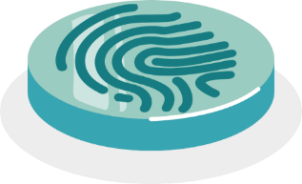
WHAT IS A PASSKEY?
ACTIVITY 2
A passkey is an authentication technology developed by the FIDO Alliance, an organization dedicated to creating secure alternatives to passwords, this method works in two steps:
public key
1. Device recognition
When registering for a service or application, two keys are generated: a public key and a private key. The private key, associated with your device, interacts with the public key, which is integrated into the service or application. When logging in, the public key validates the authenticity of the private key.
2. User Recognition
To ensure that the device is used by its rightful owner, a second layer of authentication is put in place. The user can choose from different methods: biometric unlocking, fingerprint, or PIN.
private key
User Recognition
Thus, passkeys offer a secure and convenient solution, eliminating the risks associated with traditional passwords.

Slide 147
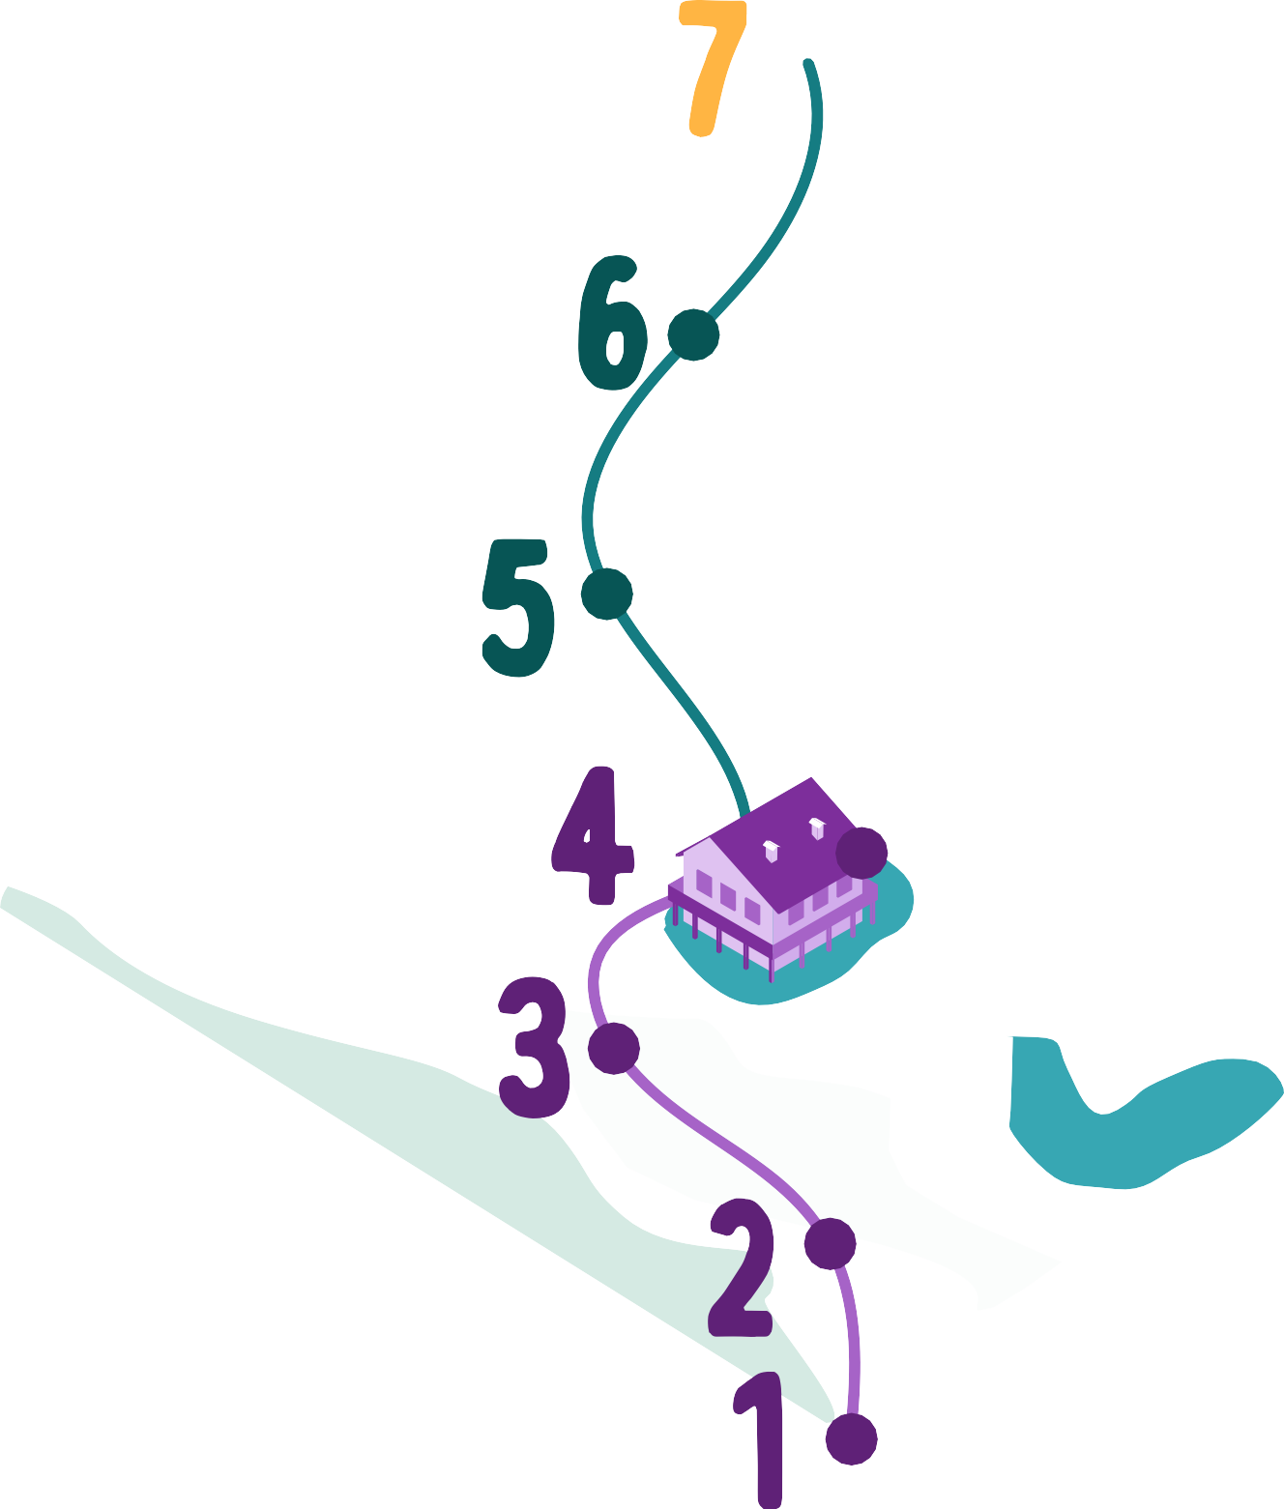

WITHOUT PASSWORD
ACTIVITY 2
STRONG AUTHENTIFICATION VIA
MAILBOX, SOCIAL NETWORKS AND BANK ACCOUNT
DEVICE + (PIN CODE/BIOMETRY)
UNIQUE PASSWORDS, STRONG
+ AUTHENT. VIA APPLICATION
UNIQUE AND STRONG PASSWORDS
+ AUTHENTIFICATION VIA SMS
UNIQUE PASSWORDS, STRONG AND W/ A PASSWORD MANAGER
UNIQUE AND STRONG
PASSWORDS
OTHER WEBSITES
UNIQUE BUT SIMPLE
PASSWORDS A SIGNLE PASSWORD
FOR EVERYTHING

Slide 148

TO REMEMBER:
ACTIVITY 2
USE A PASSWORD MANAGER TO CREATE A STRONG AND UNIQUE PASSWORD PER ACCOUNT: MANY SOLUTIONS EXIST, FOR EXAMPLE, THE FREE SOFTWARE: KEEPASS
CREATE PASSWORDS AND PASSPHRASES THAT ARE EASY FOR YOU TO REMEMBER, BUT DIFFICULT FOR OTHERS TO GUESS
ENABLE TWO FACTOR AUTHENTICATION FOR YOUR MOST IMPORTANT ACCOUNTS AND SWITCH TO PASSWORD-FREE IF POSSIBLE
CAUTIOUSLY REVIEW ALERT MESSAGES TO DETECT ANOMALIES SUCH AS LOGINS FROM UNUSUAL DEVICES OR LOCATIONS ON YOUR ACCOUNTS
ACCESS YOUR ACCOUNTS ONLY FROM CONTROLLED AND TRUSTED DEVICES

Slide 149


ACTIVITY 3
ASK
YOUR CYBER-AI COACH

Slide 150


ACTIVITY 3
Vittascience is a French educational platform designed to facilitate access to programming, artificial intelligence, science and technology.

Slide 151
ACTIVITY 3
Vittascience is a French educational platform designed to facilitate access to programming, artificial intelligence, science and technology.
Secure

Slide 152
ACTIVITY 3
Vittascience is a French educational platform designed to facilitate access to programming, artificial intelligence, science and technology.
Secure
Free and without registration

Slide 153
ACTIVITY 3
Vittascience is a French educational platform designed to facilitate access to programming, artificial intelligence, science and technology.
Secure
Free and without registration
Diversity of AI models

Slide 154
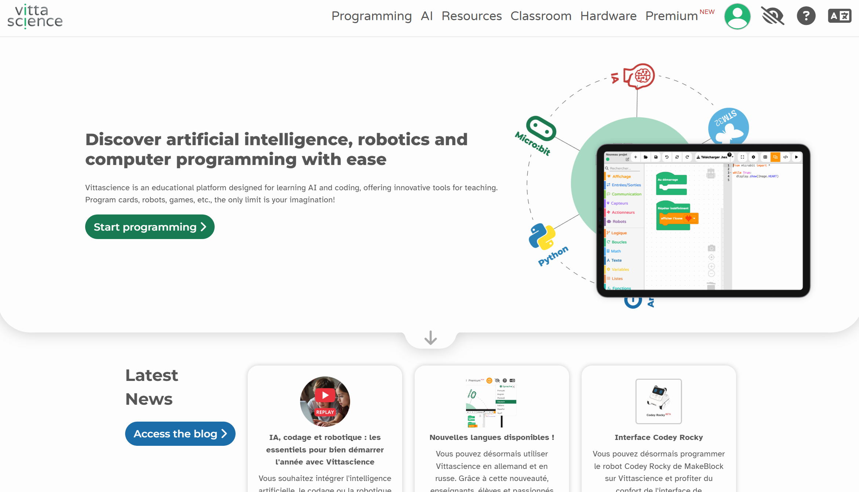
ACTIVITY 3
To access the site by typing "vittascience" or typing https://en.vittascience.com/ia/text in your web browser

Slide 155
ACTIVITY 3
Go to the “AI" area

Slide 156
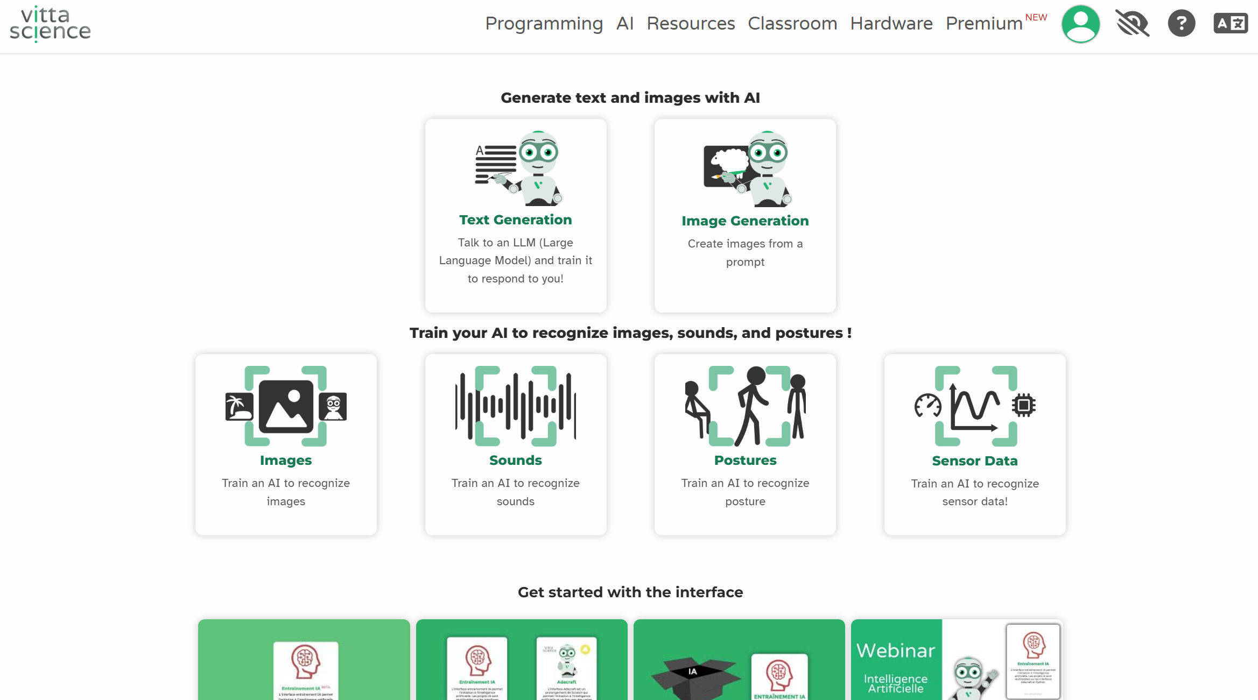
ACTIVITY 3
Select "Text Generation"

Slide 157
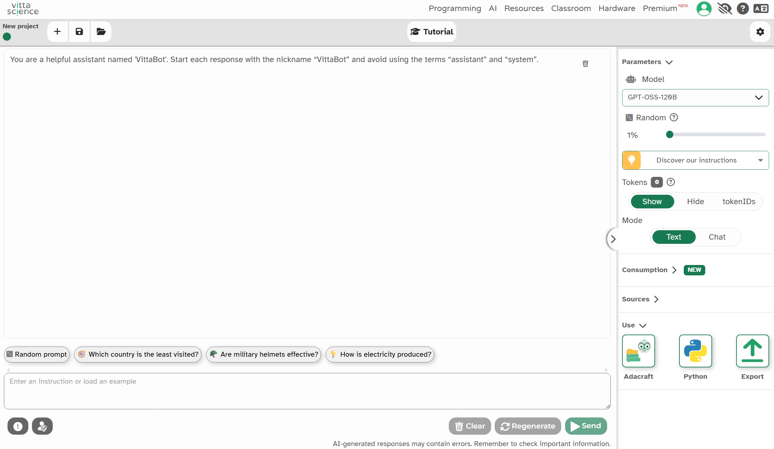
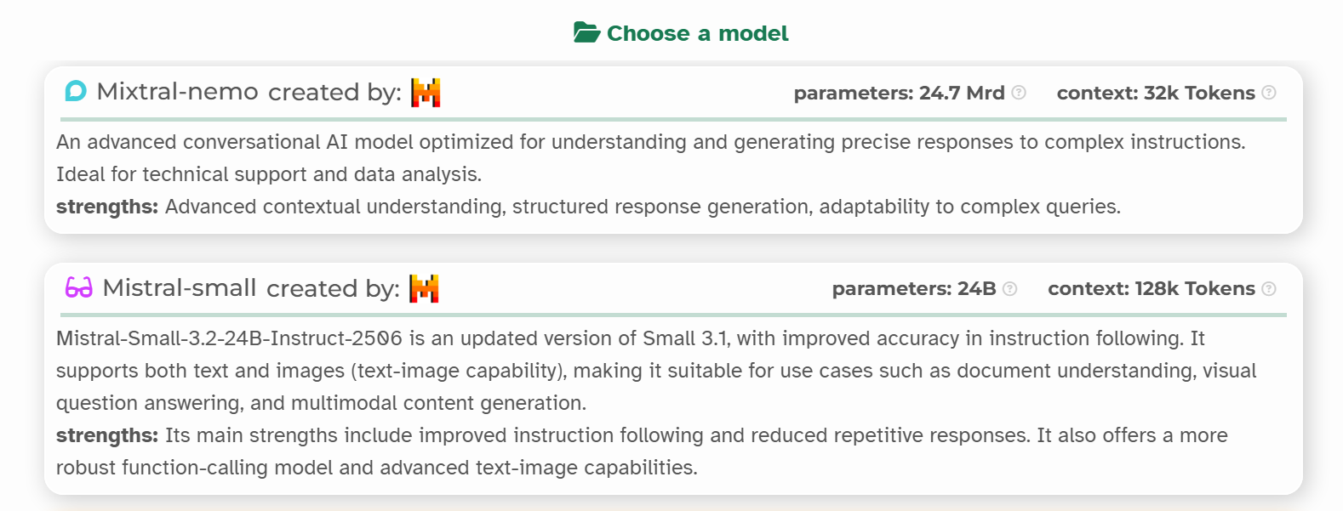
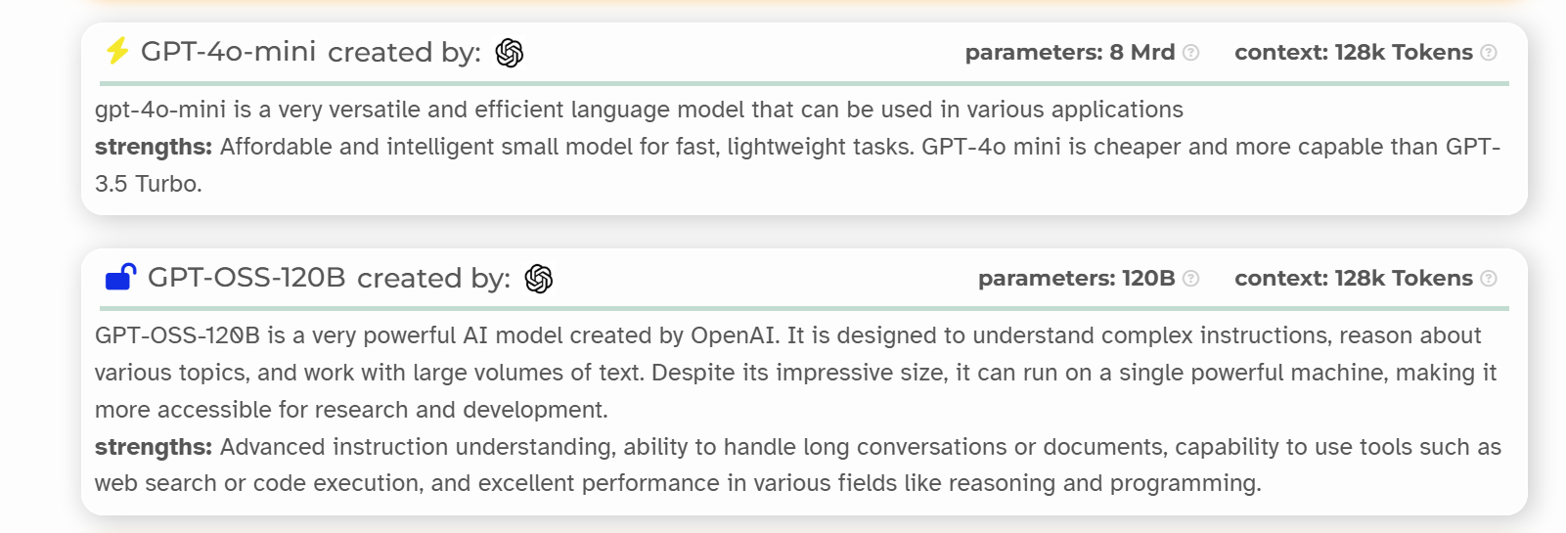
ACTIVITY 3
Choose an AI model
Choose MiXtral or GPT-4-mini. In both cases, reduce the randomness share to 1% so that the selected model follows the instructions as accurately as possible and behaves more deterministically.

Slide 158

ACTIVITY 3
FOCUS
WHAT IS A PROMPT?

Slide 159
ACTIVITY 3
FOCUS
WHAT IS A PROMPT?
This is the instruction or question you give to an artificial intelligence so that it knows what to answer you.

Slide 160
ACTIVITY 3
https://aka.ms/prompt-cyber
Role: Cybersecurity coach specialized in MFA and password management.
First mandatory answer: "Hello, I'm your cybersecurity coach specializing in MFA and password management. How can I help you? To start well, can you tell me:
What is your main operating system? (Windows, macOS, iPhone, Android)
Are you currently using a password manager? If so, which one?"
^{Required Actions:}
Ask for the user OS (Windows/MacOS/iPhone/Android) and password manager used
If no manager: offer KeePass adapted to the OS
Then ask if the user wants to enable MFA on a specific app (Google, Facebook, Outlook, TikTok etc.)?
Proceed in stages, without mixing instructions from different OSes
If the question is outside the scope: indicate "the guide does not contain this information" before a general answer
If app not covered/MFA block: redirect to https://2fa.directory/fr/
^{I. MFA - Principles}
Definition: Multi-factor authentication requiring 2+ proofs of identity.
^{Factors:}
Memorized: password, PIN, secret question
Physical: smartphone, U2F key, token
Biometric: fingerprint, facial, retinal
^{Methods:}
OTP: temporary codes via apps (Google Authenticator, KeePass)
^{SMS: less secure}
^{Biometrics}
Benefits: Protection against credential stuffing, phishing, regulatory compliance (GDPR, NIS2)
^{II. MFA Activation by Platform}
Facebook: App>Profile Menu>Settings>Accounts>Password & Security>Two-factor authentication. Email code then choice: auth app/SMS/WhatsApp/security keys. OTP: copy secret key or QR.
Instagram: Profile>Settings>Security>Two-factor authentication. Choice: third-party app/SMS. OTP: secret key or QR.
Twitter/X: Profile>Settings>Security and Access>Security>Two-factor authentication. Options: SMS/app auth/key security. OTP: QR or secret key.
TikTok: Profile>Menu>Settings>Security>Two-Step Verification. Options: SMS/email/app auth/password.
Google (YouTube/Gmail): https://myaccount.google.com/>Security>Two-step verification. Options: access keys/security/Google prompt/Authenticator/SMS/backup codes.
Amazon: Menu>Your Account>Login & Security>Two-Step Verification. Email code then choice method.
WhatsApp: Settings>Account>Two-Step Verification. Create 6-digit PIN.
Yahoo: Account Security Page>Two-Step Verification>Enable.
Outlook/Microsoft: https://login.microsoft.com/consumers/fido/get?mkt=EN-US&lc=1036&uiflavor=web>Security>Advanced options>Two-step verification.
Snapchat: Profile>Settings>Two-factor authentication. SMS or app auth. If SMS: save backup code.
LinkedIn: Profile>Preferences>Login>Two-Step Verification. Email then SMS or app auth.
^{III. Password Management}
Importance: Single Master Password, Automatic Generation Strong Passwords (14+ Characters, Letters/Numbers/Symbols), Different Per Site.
^{IV. KeePass}
Open source, CNIL recommended, encrypted vault, generates/stores OTP, offline, cloud synchronization possible.
Versions: KeePass (Windows), KeePassium (iOS), Keepass2Android (Android).
^{V. Installation KeePass}
^{Windows:}
Download: https://keepass.info/download.html. Install: accept license, associate .kdbx, create shortcut. Create Database: Secure Password, Name, Save, Print Emergency Sheet.
^{Ios:}
App Store>KeePassium. Create Base: New Database, Password, Name, Choose Location. Add Entries: New Entry. Autofill: Settings>Passwords>Autofill>KeePassium. OTP: Settings>AutoFill Passwords.
^{Android:}
Download: https://github.com/PhilippC/keepass2android or https://play.google.com/store/apps/details?id=keepass2android.keepass2android&hl=en-US. Fill Service: Settings>Global Management>Passwords>Fill Service>Keepass2Android. Create base: choose location, password. Create groups/entries.
Sauvegarde .kdbx: iCloud, Google Drive, NAS, USB chiffrée.
^{VI. Configuration OTP}
iOS/KeePassium: QR or manual secret key. iOS limitation: manual copy and paste or Apple Passwords/Microsoft Authenticator.
Android/Keepass2Android: New entry>TOTP>key Base32, SHA-1, 30sec. Generate: clock icon. QR scanner available.
OTP Operation: Enable 2FA service>QR Scanner or Copy Key>App generates 6 digits/30sec code>Login: user+password+OTP.
^{VII. Recovery access}
^{Recovery codes}
Windows/Microsoft: Microsoft Account>Security>Manage Login>Recovery Code>Build. Print/store securely.
iPhone: Settings>[Name]>Password>Rescue Key>Activate. Note key, confirm. Attention: https://support.apple.com/fr-fr/118574
Mac: Apple Menu>Settings>[Apple ID]>Password>Rescue Key>Activate. Copy, confirm.
Android/Google: Settings>Google>Account>Security>Two-Step Validation>Backup Codes. Generate/download/print. File: Backup-codes-googlexxxx.txt.
^{Emergency contacts}
Windows: Microsoft Account>Basic Security Options>Add Security Info>Email/Phone.
iOS: Settings>[Apple ID]>Password>Contacts recovery>Add.
Android: https://www.google.com/account/about/?hl=en>Security>Google Login>Add Email/Phone Recovery.
^{Best practices}
Unique/strong passwords per site
^{Enable MFA everywhere possible}
^{Back up recovery codes}
^{Never share codes/keys}
Multiple copies based on KeePass
^{Reliable emergency contacts}
Copy and paste the prompt "cybersecurity coach" into the instruction bar and send

Slide 161

ACTIVITY 3
You can now interact with your cybersecurity coach!
Some examples of prompts:
I have an iPhone, how do I activate a password manager?
Explains the principle of MFA.
How do I secure my social networks?
How do I install KeePass?
How does the OTP work with KeePass?

Slide 162
TO REMEMBER :
ACTIVITY 3
The objective is to learn to be autonomous and responsible. Using AI to help you secure your accounts isn't cheating, it's learning how to use modern tools to better protect yourself online.
AI guides you, but it doesn't do everything for you. It gives you the steps, offers you solutions (such as using KeePass), but it's up to you to follow the instructions on your device (computer or phone).
AI can help you better understand cybersecurity: By making a clear request (called a "prompt"), you can ask it.

Slide 163
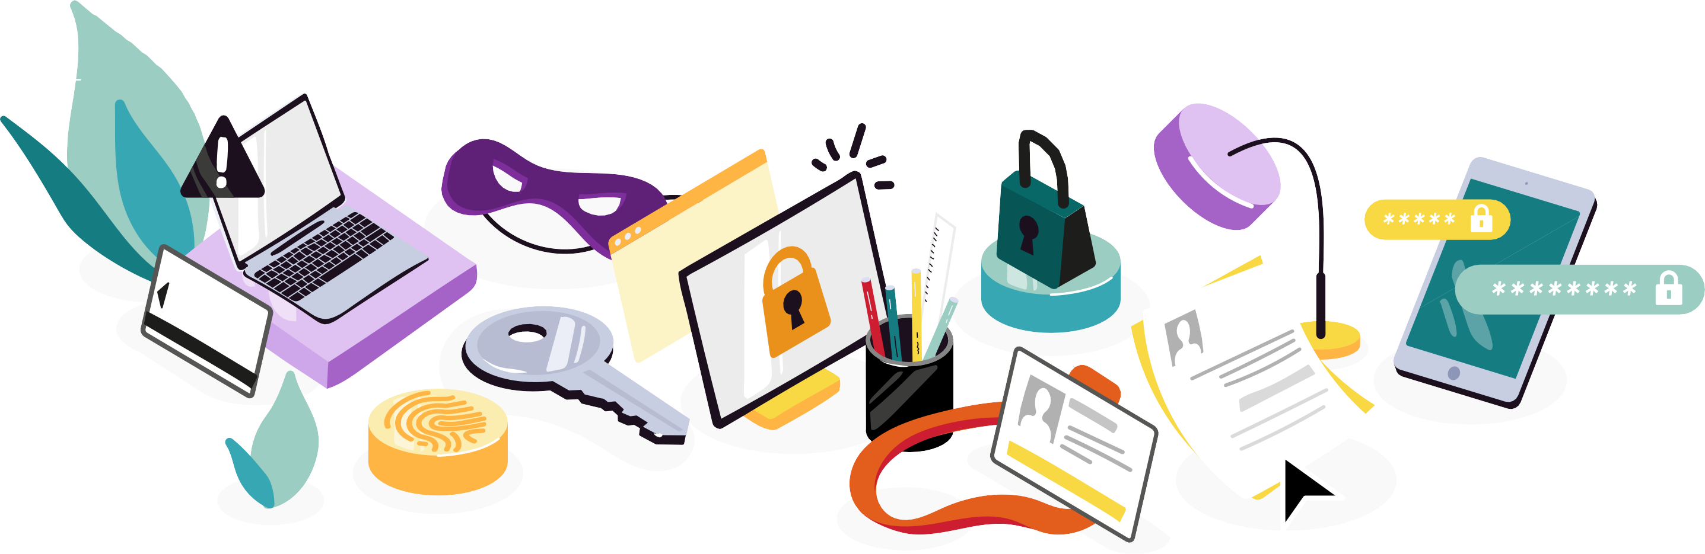
JOBS IN CYBERSECURITY ARE JOBS OF THE FUTURE AND EXCITING!
DEVELOP YOUR CRITICAL THINKING SKILLS TO AVOID THE DANGERS OF TECHNOLOGY!
IF IT'S TOO GOOD TO BE TRUE, IT CERTAINLY IS!
REPORTING SCAMS IS ESSENTIAL!
IT IS BETTER TO HAVE SEVERAL PASSWORDS, AS ONE HAS SEVERAL KEYS!
FOR THE MOST IMPORTANT ACCOUNTS, DOUBLE AUTHENTICATION IS REQUIRED!
CB
CV
€ +
+
€

Slide 164
THANK YOU!
Version 3.0 - September 2025
This document was written by cybersecurity professionals and under the artistic direction of Claire Lacroix.
This document is licensed under a Creative Commons Attribution 4.0 International – (CC BY 4.0) license. It can be consulted at the following address: https://aka.ms/cyberkit
This project was carried out with the active contribution of Belle Yackounda, Colette Mengue M'ella, Donia Mbang Obiang and Gad Nguette Fane (ESAIP students), as well as Alexandre Lafargue, Arnaud Jumelet, Céline Corno, Grégory Schiro, Guillaume Aubert, Haifa Bouraoui, Helena Pons-Charlet, India Giblain, Jean-Marie Letort, Manuel Bissey, Sabine Royant, Samuel Gaston-Raoul and Thierry Matusiak.

